Slide 1

Michigan Lean Consortium
Lean 101
Dave Kippen and Mark Hawks

Slide 2
Agenda
Welcome and Introductions
MLC Overview
The History Of Lean
What Is Lean and how it differs
The 8 Wastes
Standard Work Exercise
Error Proofing
5S
Sustaining and Maintaining the Concepts
What will you do Monday?
Notes:
Standard Font: Arial, size 40 for title

Slide 3
Introductions
Name
Title/Job
Knowledge or/Experience in Lean?
Expectations for the class
Notes:
Standard Font: Arial, size 40 for title

Slide 4
Agenda
Welcome and Introductions
MLC Overview
The History Of Lean
What Is Lean and how it differs
The 8 Wastes
Standard Work Exercise
Error Proofing
5S
Sustaining and Maintaining the Concepts
How Lean Differs from Traditional Business
Notes:
Standard Font: Arial, size 40 for title

Slide 5
Agenda
Welcome and Introductions
MLC Overview
The History Of Lean
What Is Lean and how it differs
The 8 Wastes
Standard Work Exercise
Error Proofing
5S
Sustaining and Maintaining the Concepts
What will you do Monday?
Notes:
Standard Font: Arial, size 40 for title

Slide 6
History of Lean
114 years ago you want to buy a car. What is the production system?
Pros?
Cons?
Enter Henry Ford. What was the system he made popular?
Pros?
Cons?
Notes:
Standard Font: Arial, size 40 for title

Slide 7
History of Lean
114 years ago you want to buy a car. What is the production system?
Pros?
Cons?
Enter Henry Ford. What was the system he made popular?
Pros?
Cons?
Along comes Eiji Toyoda and Taiichi Ohno…
The Toyota Production System tries to integrate low inventory, workers as an asset, high quality, fast delivery, low cost…
LEAN!
Notes:
Standard Font: Arial, size 40 for title

Slide 8
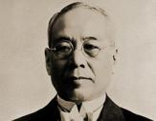
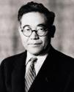
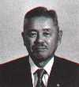

History
United States
Japan
1900
Time and Motion
F. Taylor
Interchangeable Parts
E. Whitney
1915
Jidoka
S. Toyoda
Mass Production
Henry Ford
“Today and
Tomorrow,”
1926
1935
Just-In-Time
K. Toyoda
1945
Supermarket System
Toyota Production System (TPS)
Taiichi Ohno and Shigeo Shingo
U.S. Productivity and
Quality Seminars
1973
U.S. consumers look for smaller
cars; Big 3 market share decline begins
1st Oil Shock
Japanese industry recognizes
TPS and dissemination begins
First US/Japan joint venture between GM and Toyota called NUMMI
1983
NUMMI
Globalization
MIT IMVP Study:
Lean dissemination begins
Dollar/Yen Exchange Rate
and Renewed Cost Reductions
CAMI
1990s
First Canada/Japan joint venture between GM and Suzuki called CAMI
China becoming global manufacturer
J. Womack
coined the word “Lean”
21st
The Toyota Way
Toyota Kata
Jeffrey Liker
Mark Graban
Realization of Lean Culture Importance
Lean being used in transactional and other non-mfg areas!
Lean Hospitals
Notes:
Standard Font: Arial, size 40 for title

Slide 9
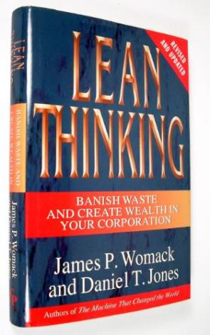







Books of Significance
Notes:
Standard Font: Arial, size 40 for title

Slide 10
Agenda
Welcome and Introductions
MLC Overview
The History Of Lean
What Is Lean and how it differs
The 8 Wastes
Standard Work Exercise
Error Proofing
5S
Sustaining and Maintaining the Concepts
What will you do Monday?
Notes:
Standard Font: Arial, size 40 for title

Slide 11
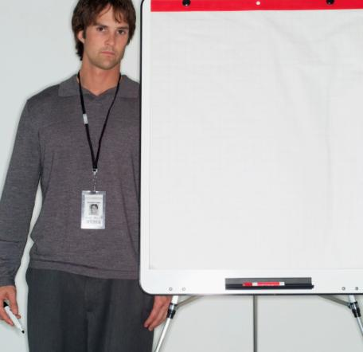
What is lean?
A dynamic process of
continuous improvement & learning
by empowered associates,
in a culture of mutual trust and respect,
focused on
eliminating waste
and
maximizing value for our customers.
Lean is the elimination of system waste
through
continuous improvement
efforts within a
culture of respect and appreciation.
Notes:
Standard Font: Arial, size 40 for title

Slide 12

What is lean?
Lean = Lean Thinking
“In short, Lean thinking is Lean, because it provides a way to do more and more with less and less -- less human effort, less equipment, less time, and less space -- while coming closer and closer to providing customers with exactly what they want.”
It is about a mindset,
a philosophy,
a culture…
Womack, J.P., & Jones, D.T. (2003). Lean Thinking. New York: Free Press, p.15.
Notes:
Standard Font: Arial, size 40 for title

Slide 13
What is lean?
Being individually accountable at all levels
Management existing to support the workforce (i.e., servant-leader mentality)
Systematically, and continuously, taking out waste or “muda” of every aspect of a company’s operation (across the value chain)
Challenging the tradition and status quo
Asking questions to Learn
Notes:
Standard Font: Arial, size 40 for title

Slide 14
What is lean?
Bringing out the best in all people and allowing teams to develop ideas and implement changes
Helping and not criticizing
Aiming for perfection, but accept excellence
Reflection time (hansei)
True teamwork
Notes:
Standard Font: Arial, size 40 for title

Slide 15
What is lean?
A focus on long-term, sustainable changes (as opposed to short-term gains) by making small, incremental changes continuously
A way of life, never ending journey toward world-class status
“No-blame” environment; a fear-free environment!
A never-give-up attitude
Change and Action oriented
Becoming “fit” or “athletic” or “strong” or “agile”
in terms of business and operational performance
Notes:
Standard Font: Arial, size 40 for title

Slide 16
What is lean?
Changes in Management & Leadership Functions in a Lean Organization
SUPERIOR COACHING
ATTRIBUTES
Ask
Lead
Train/ Educate
Understand All Players
Vertical & Horizontal Alignment
Listen
Share in Goal Setting
Empower Others
Teams (Team spirit)
TRADITIONAL
MANAGEMENT STYLE
Tell
Direct
Autocratic
Dictatorial
Communication Top-Down
Use Authority
Impose Goals
Limit Performance
Individuals (“Me” theory)
Notes:
Standard Font: Arial, size 40 for title

Slide 17
How Lean Differs?
Traditional: Improve system (disregarding all of the types of waste in the process).
Lean: Improve system by 1) Eliminating waste and 2) Improving current processes.
Traditional: Management is the primary driver of change.
Lean: Everyone is empowered, trained in the principles of lean and encouraged to look for ways to improve processes.
Traditional: If a process is working (if it ain't broke) don't fix it.
Lean: Always look for ways to improve processes
Traditional: Problems are viewed as just that, problems.
Lean: Problems are viewed as opportunities for improvement often through root cause analysis.

Slide 18
How Lean Differs?
Traditional: Standardized work (people performing the same task the same way) only exists in documents like SOPs, rarely in reality.
Lean: Everyone performs the same task the exact same way until a better way is discovered; then everyone performs the task the new and improved way.
Traditional: Focuses on training and relies on people to not make mistakes.
Lean: Focuses on building processes that are error proofed (a person cannot make a mistake or it would be difficult to do so).
Traditional: Systems thinking (views the organization as a whole), often ignoring or unable to see the enormous opportunities for improvement.
Lean: Views the organization as a series of interrelated processes that can and should be improved.

Slide 19
How Lean Differs?
Looking Lean Being Lean
Focus on reducing costs Grow the business by improving processes
Projects Business strategy
Delegated leadership Top led, constant reinforcement
Set of “tools” Value Stream Perfection
Complex metrics Simple, visual, customer focused metrics
Department/function focused Customer defined value focus
Pushing to sustain results The “fly wheel”. Everyone gets it & owns it
Results Focus Process Focus
Wondering “Are we lean yet?” Knowing this is a never-ending journey & it is not about “getting there”

Slide 20
Lean Progression
Fixed State – Being Lean
Continuous Change – Becoming Lean
Set of Tools – Doing Lean
Lean Philosophy – Lean Thinking

Slide 21
In a Lean Enterprise:
Everyone can see the waste causing business problems
Everyone knows which tools to use to get rid of the waste
Everyone focuses on products, not silos or organizations
Everyone relentlessly pursues waste elimination every day
Everyone knows “looking lean” vs. “being lean”
Everyone wants to see and break rocks.
Everyone understands that we must constantly reduce costs

Slide 22
What is Lean?
Being a coach at all levels of the organization is part of the uniqueness of lean.
What are some attributes of a good coach?
  List on flipchart and discuss
Notes:
Standard Font: Arial, size 40 for title

Slide 23
Exercise: Effective Coaching
On a piece of paper, DRAW something that represents a coach on the LEFT and write characteristics of a good coach on the RIGHT. Everyone must draw. (5 minutes)
Pass the papers around the room one at a time reading and looking at each others’ interpretations.
On the flipchart, write down the most repeated words.
For each characteristic, rate yourself on a scale of 1 to 5 (1 being “I am not this at all”, 5 is “I am this all the time”). (3 minutes).
Divide into groups of 3 and share your best practices for the areas you rated yourself a 5 and ask for assistance in areas you scored a 1 or 2 (15 minutes). If not enough time, do this as a large group.
Share some ideas with the entire group when reconvening.

Slide 24
What is lean?
The bottom line…
Lean fundamentals
The basic principles of Lean:
  Focus on the customer.
  Improve the value stream.
  Maintain flow. If you can’t flow, create pull!
  Strive for perfection but accept excellence.
  Respect people
  Make people before parts!
Notes:
Standard Font: Arial, size 40 for title

Slide 25
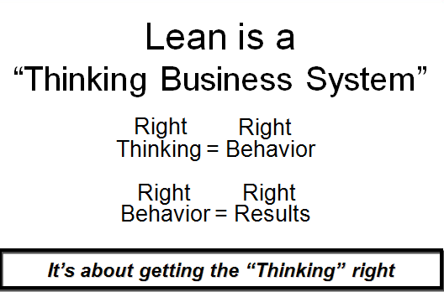

Slide 26

Agenda
Welcome and Introductions
MLC Overview
The History Of Lean
What Is Lean and how it differs
The 8 Wastes
Standard Work Exercise
Error Proofing
5S
Sustaining and Maintaining the Concepts
What will you do Monday?
Notes:
Standard Font: Arial, size 40 for title

Slide 27
The 8 Wastes
VA = Value-Added
  Any time someone is working on something that has a direct impact on producing the product or providing the service to the customer.
NVA = Non-Value-Added
  Any activities that are performed, but do not contribute to the product or service being produced (i.e. waiting, searching for something, etc --- basically, The 8 Wastes)
NVA-R = Non-Value-Added but Required
  These are activities that do not contribute directly to the product or service, but are absolutely necessary and typically cannot be removed from the process, but could still be improved in some way. (i.e. waiting for paint to dry before the next coat, most management functions(!), moving a patient from ER to X-Ray)
  Also called ‘necessary non value added’
ALL activities can be improved --- even if they are
value-added – it is usually a question of priority,
impact or resources available.
Notes:
Standard Font: Arial, size 40 for title

Slide 28
GRAPHIC OF ANY TYPICAL VALUE STREAM
The 8 Wastes
NON VALUE ADDED
VALUE ADDED
Typically 95% of
a process is
Non-Value Added!
SO WHY DO WE
FOCUS HERE?
Notes:
____________________________________________________________________________________________________________________________________________________________________________________________________________________________________________________________________________________________________________________________________________________________________________________________________________________________________________________________________________________________________________________________________________________________________________________________________________________________________________________________________________________
AN INTERESTING POINT:
Without implementing a Lean approach, waste generally accounts for 85-95% of total lead time in business.
Value-added
Non value-Added
There are 8 different types of waste. GDC taught us the acronym DOWNTIME to remember all of them.
(Read the list) Each of these will be reviewed with a little more depth on the next 2 slides.

Slide 29
The 8 Wastes
D
O
W
N
T
I
m
e
Notes:
An activity that can be done with the 8 Wastes is dividing the group into 8 Teams…. Assign each team a letter and have them come up with examples of their Waste and present to the group.

Slide 30
The 8 Wastes
D
For defect waste ask:
Do we have data entry errors?
Do we have pricing, quoting, billing, or coding errors?
Do we forwarding partial documentation to the next process?
Do we ever loose files or records?
Do we ever encounter incorrect information on a document?
O
For overproduction or unnecessary service waste ask:
Are we producing more reports than needed?
Are we making more extra copies than needed?
Are we printing, faxing, e-mailing more than what is needed?
Are we entering repetitive information on multiple work documents or forms?
Are we ordering more services than what is required by the customer?
W
For waiting waste ask:
Are there excessive signatures or approvals required?
Is there too much dependency on others to complete a task?
Are there delays in receiving information?
Are there computer program version problems causing delays?
Are there cross-departmental resource commitments issues?
N
For the non- or under-utilization of people ask:
Are we in positions we were trained to do?
Can we assist other areas when work is slow in an area?
Can we be trained to do more within the organization?
Notes:
An activity that can be done with the 8 Wastes is dividing the group into 8 Teams…. Assign each team a letter and have them come up with examples of their Waste and present to the group.

Slide 31
The 8 Wastes
T
For transport waste ask:
Are you delivering documents that are not required?
Are you doing excessive filing of work documents?
Do drivers/delivery people have to go back-n-forth?
For inventory waste ask:
Are files (or work) awaiting excessive signatures or approvals?
Are files awaiting task completion by others?
Are we purchasing excessive supplies of any kind?
Do we have any obsolete files in the area?
Do we have obsolete equipment in the area?
I
M
For motion waste ask:
Are you searching for computer files on your desktop?
Are you searching for work documents (files) in cabinets and/or drawers?
Are you constantly reviewing the same manuals for information?
Are you hand-carrying paper work to another process or department regularly?
E
For extra- or over-processing waste ask:
Are we duplicating reports or information?
Are we entering repetitive data?
Are we doing more work than is required for that process?

Slide 32
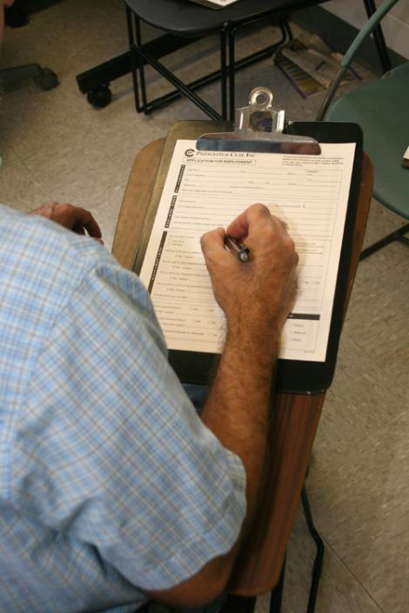
Defects/Mistakes/Corrections
The 8 Wastes
Any time we have to correct, fix, repair, rework mistakes
In other words, “touch it twice” because we didn’t do it right the first time
Typo’s, missssspelling, grammar, math, negligence, assumptions
Typically, sign-off’s and double-checks are the result of a mistake that was made at some point and someone decided to “check it” in order to fix the problem.
  QUESTION: Do “sign-off’s” fix the problem?
Notes:
Ask for examples from the class

Slide 33
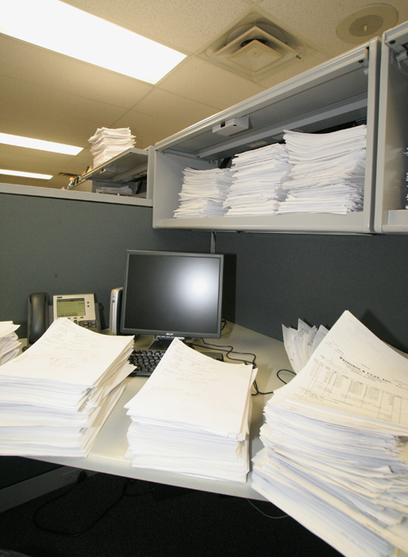
Overproduction
The 8 Wastes
Any time we make more or do more than is required “just in case…”
Extra manuals, forms, duplicate/triplicate, “group” emails
  “Group” email lists – pro’s and con’s
Why do companies overproduce items?
Notes:
Ask for examples from the class

Slide 34
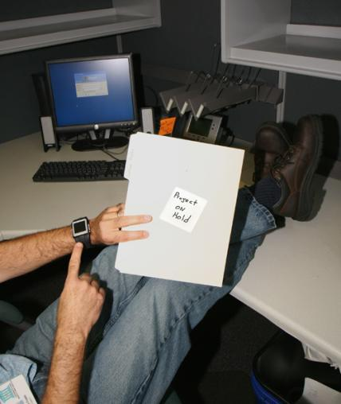
Waiting
The 8 Wastes
Whenever an employee has to WAIT because of a factor outside of their control
Hand-off’s, sign-off’s
Downtime (i.e. computer, internet, machine)
Postponements (meetings, schedules)
Waiting for people to show up for a meeting (or conference call)
Not having what is needed, when it’s needed, where it’s needed
What are some of the ramifications of people waiting? Give examples.
Notes:
Ask for examples from the class

Slide 35
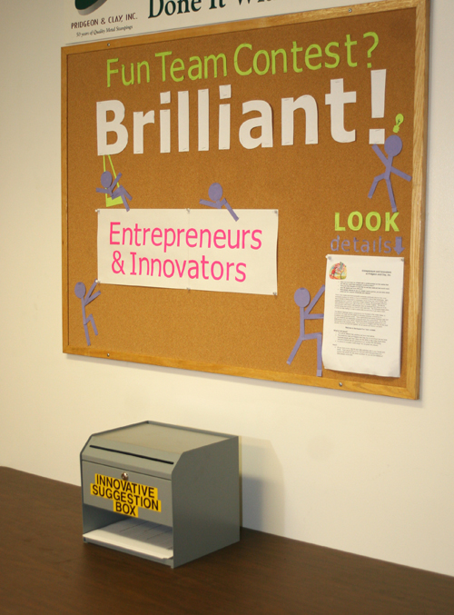
Non-Utilized/Neglected Talent
The 8 Wastes
Ties to Lean Culture
Historically, we did not use the “brain power” of our employees
They were TOLD what to do, not ASKED what they could do
Empowerment
Can we honestly trust workers to make decisions about their jobs that might effect the company?
Notes:
NB: This is the “new” waste….. Original books and documents refer to the SEVEN WASTES, but there had been so much discussion about wasted personnel and underutilized talent in companies, that most documents, articles and books have accepted this as the 8th waste. For the purposes of this class, we will call it The Eight Wastes.

Slide 36
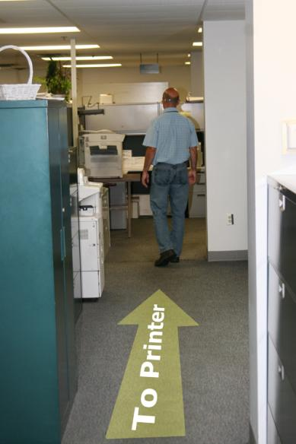
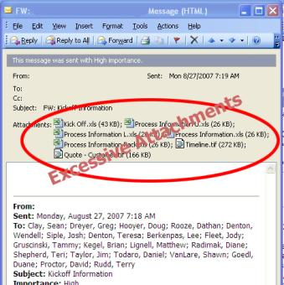
Transportation
The 8 Wastes
Any time we physically move something or someone unnecessarily or further than might be necessary.
  Chatting along the way
  Distance traveled
  Hand-off’s the other side of the building
  Moving patients around for tests in hospitals.
Describe long or excessive walks you have to make every day or
erratic routes your hi-low drivers make, etc.
Notes:
Ask for examples from the class

Slide 37
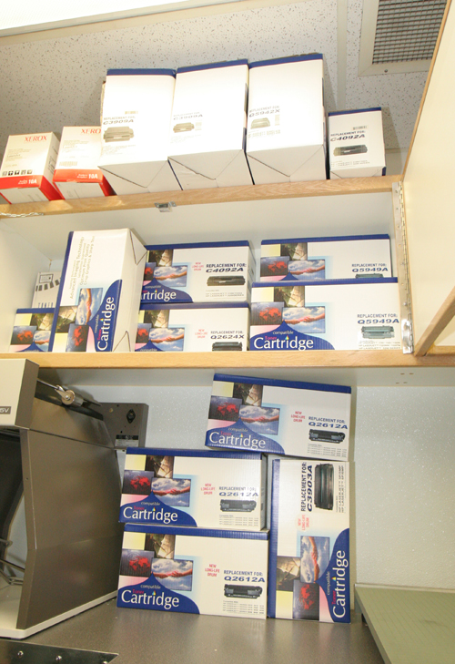
Inventory
The 8 Wastes
Inventory (no matter how small) sucks up real estate, money, effort, and aggravation
  Determining what is the RIGHT amount is critical.
  Incoming, WIP, Finished Goods.
    Give examples of each from multiple industries.
Obsolescence and damage are huge considerations with excessive inventory.
Kanban
Bulk purchasing – “Sin or savings?” Explain.
Notes:
Ask for examples from the class

Slide 38

Motion
The 8 Wastes
Wasted human motion or effort
Ergonomics
Potential safety issue
Time-waster
  (1-second example)
What motions exist in your company that could cause injury and/or that waste time and effort?
Notes:
Ask for examples from the class

Slide 39
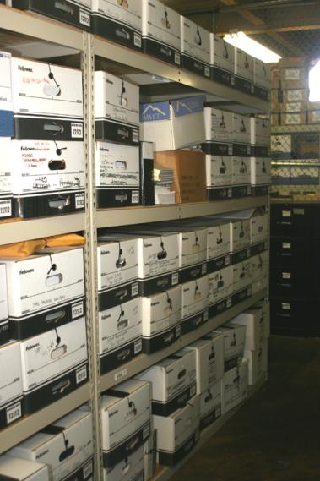
Extra Processing
The 8 Wastes
Any time we do something over-and-above what we should do or have to do because our SYSTEM is not robust enough
This one often encompasses some of the other wastes (ie. Defects that cause extra processing).
Excessive copies because we don’t know how many people are coming to a meeting.
Making reports for people who don’t actually want or need them.
Polishing a part when it is not required or mandated.
What are the ramifications of extra processing?
Notes:
Ask for examples from the class

Slide 40
The 8 Wastes
Waste
Walk-Around
Activity
Try to spot examples of each of the wastes at your work, home or an organization that you visit. Learn to see the waste.

Slide 41
The 8 Wastes

Slide 42
Agenda
Welcome and Introductions
MLC Overview
The History Of Lean
What Is Lean and how it differs
The 8 Wastes
Standard Work Exercise
Error Proofing
5S
Sustaining and Maintaining the Concepts
What will you do Monday?
Notes:
Standard Font: Arial, size 40 for title

Slide 43
Standard Work
Lean Fine Arts Company
Our one and only job is to draw fine Pig artwork!
We have been drawing fine Pigs for over 100 years and our customer expects consistency!
We have been so good, our demand is through the roof and you new hires need to get with it, ASAP!
Now draw me some pigs so we can make money!
Notes:
Standard Font: Arial, size 40 for title

Slide 44
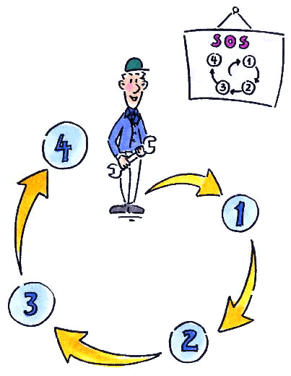
Standard Work
Definition:
The current best documented method to safely and efficiently organize work elements in a repeatable sequence that we know of TODAY.
First I…
Then I…
Then I...
Notes:
Standard Font: Arial, size 40 for title

Slide 45
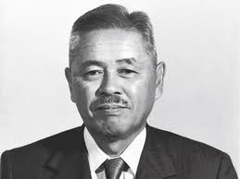
Standard Work
“WITHOUT STANDARDS, THERE CAN BE NO IMPROVEMENT” – TAIICHI OHNO
What does this mean?
Notes:
Standard Font: Arial, size 40 for title

Slide 46
Standard Work
Why Standard Work Instructions?
Traditional Method
Result 1
Result 2
PEOPLE
Result 3
People doing “whatever it takes” often get undefined results
PEOPLE
Standardized Work
DEFINED
RESULTS
Lean
Method
People using repeatable standard processes get defined results
Notes:
Standard Font: Arial, size 40 for title

Slide 47
Standard Work
DO:
  Keep standard work simple
  Make it accessible
  Include all info on one, easy-to-read document
  Create one standard work document for each part of the process
  Always look for ways to improve the process.
DON’T:
  Put standard work in a desk drawer
  Change processes without changing standard work
  Make standard work difficult to change
  Give up on standard work – it can be tough, but it’s very important
Notes:
Standard Font: Arial, size 40 for title

Slide 48
Standard Work
Sharing Our Experiences:
What standard work have you seen work, or not work! Share the good, bad and ugly!
Notes:
Standard Font: Arial, size 40 for title

Slide 49
Agenda
Welcome and Introductions
MLC Overview
The History Of Lean
What Is Lean and how it differs
The 8 Wastes
Standard Work Exercise
Error Proofing
5S
Sustaining and Maintaining the Concepts
What will you do Monday?
Notes:
Standard Font: Arial, size 40 for title

Slide 50
Error Proofing
Sorting and Inspection Co.
Our company goal is to find all the letter “F’s” for our clients
We get paid by the F, so its imperative that we find them all
Work is piling up, so work through your task as fast as you feel comfortable
OK, go to work!
Notes:
Standard Font: Arial, size 40 for title

Slide 51
Error Proofing
How many got more than 25?
More than 30?
More than 35?
More than 40?
45?
46?
47?………
Notes:
Standard Font: Arial, size 40 for title

Slide 52
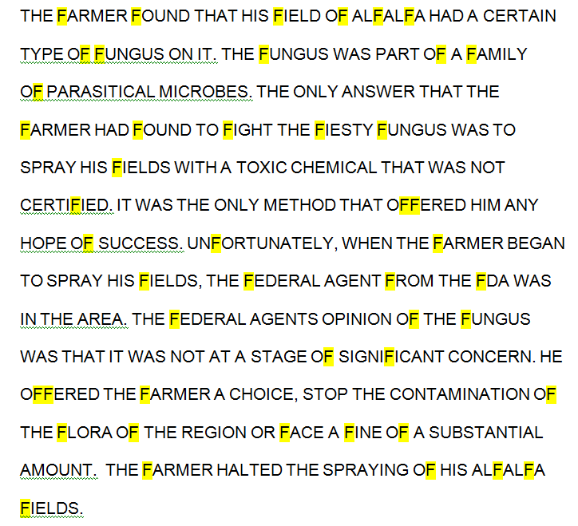
Error Proofing
Notes:
Standard Font: Arial, size 40 for title

Slide 53
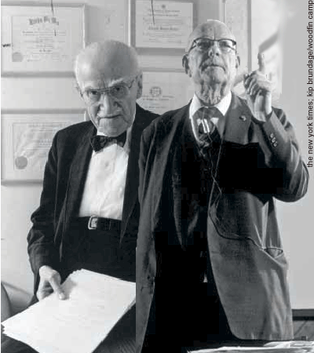
Error Proofing
In 100% inspection there is an 80% chance of finding the problem (if it exists). If two people inspect the item, the chance of finding the problem drops even further!
Why? Inspector 1 thinks inspector 2 will catch the defect while inspector 2 thinks inspector 1 will catch it. Net result: nobody inspecting.
- From Juran / Deming
Notes:
Standard Font: Arial, size 40 for title

Slide 54
Error Proofing Levels
Instruction in SOP about quality specification
Inspect for defects “after the fact”
Visual human inspection during a process
Audible or visual signal if error occurs
Automatic shut down if error occurs
Physically impossible to make a mistake
Which are detection, which are prevention?
Notes:
Standard Font: Arial, size 40 for title

Slide 55
Error Proofing
Everyday Examples:
Your car
Your mower
Online forms
Memory cards
Computer cords
Inter office mail envelopes
What Error Proofing Is Not:
Change to SOP
Adding a second check
Adding a sign off
Retraining someone
Firing someone
Notes:
Standard Font: Arial, size 40 for title

Slide 56
5-Why – “Simple” Root Cause Tool
The vehicle will not start. (the problem)
What caused the vehicle to not start?
The starter would not turn over
Solution: Replace the starter. Will this permanently fix the problem?
What caused the starter would not turn over?
The battery was not charged
Solution: Re charge the battery. Will this permanently fix the problem?
What caused the battery to not charge?
The alternator did not charge the battery
Solution: Replace the alternator. Will this permanently fix the problem?
What caused the alternator to charge the battery?
The alternator belt has broken
Solution: Replace the belt. Will this permanently fix the problem?
What caused the alternator belt to break?
The alternator belt was well beyond its useful service life and not replaced.
Solution: Replace the belt before it fails. Will this permanently fix the problem?
What caused the alternator belt to not be replaced?
The vehicle was not maintained according to the recommended service schedule
Solution: Follow the standard maintenance schedule for belt replacement
If unsure, you can always test!

Slide 57
The 5 Whys Worksheet
Name: ____________________ Date:________
What is the abnormal condition?
Cause or symptom?
Solution
Why did this occur (1)?
Cause
Symptom
Why did this occur (2)?
Cause
Symptom
Why did this occur (3)?
Cause
Why did this occur (4)?
Cause
Symptom
Why did this occur (5)?
Cause
Symptom
Root Cause

Slide 58
Reminders
More often than not, the true root cause will come down to a cultural or process deficiency
You “can” stop after almost each why, but “should” you? Will you really solve the problem?
Be careful not to use a detection failure as a step. Not detecting something does not cause the failure!
5Y can be tricky to use at first, it is often not as simple as it seems. Follow the guidelines and you will find success!

Slide 59
Error Proofing
Sharing Our Experiences:
What error proofing have you seen work, or not work! Share the good, bad and ugly!
Notes:
Standard Font: Arial, size 40 for title

Slide 60
Agenda
Welcome and Introductions
MLC Overview
The History Of Lean
What Is Lean and how it differs
The 8 Wastes
Standard Work Exercise
Error Proofing
5S
Sustaining and Maintaining the Concepts
What will you do Monday?
Notes:
Standard Font: Arial, size 40 for title

Slide 61
5S
Japanese S English S
1. Seiri Sort
2. Seiton Straighten/Store
3. Seiso Shine
4. Seiketsu Standardize
5. Shitsuke Sustain/Self-Discipline

Slide 62
5S
To Do Steps
To Maintain Steps
1) Sort (Sort through & Sort out)
Keep what’s needed -- eliminate what’s not…
2) Straighten (Set-in-Order & Set Limits)
Where shall we put it? How shall we store it?
3) Shine (and inspect through cleaning)
Clean it up and prepare to keep it clean.
4) Standardize (and share information)
Design and implement Visual Controls
Standardize tools and procedures
5) Sustain (Self-Discipline)
Train everyone to new standards
Audit system
Continue to improve

Slide 63
5S
2
1
3
THE NUMBERS GAME
Pretend that you have 36 items that you use every day in your work area.
In 15 seconds find all of the numbers from 1 – 36 -- IN ORDER.
Notes:
Basic instructions slide

Slide 64
38
77
22
64
61
58
45
43
27
3
28
15
2
6
55
54
42
63
68
47
8
74
36
71
99
7
9
40
20
11
51
32
73
25
31
43
67
73
76
16
98
1
13
41
14
46
18
56
65
70
60
58
53
36
62
26
19
34
21
23
24
49
72
55
41
78
61
97
17
38
50
10
44
25
29
57
52
30
69
37
66
77
35
48
5
33
4
39
12
59
75
41
63
99
Notes:
SAY: You have 26 items that you use MOST often every day at your desk. Looking at this slide, find (in order) as many of the 26 items as you can. [ALLOW 15 SECONDS]
SAY: How many did you find? [Most people will only get to 4-6]
NOTE: There are almost 100 numbers on the page – Number 41 is on there three times. These numbers represent the extra “stuff” on the desk or in the work area. This is the perfect lead into STEP 1 – SORT – see next slide.

Slide 65
How many did you get?

Slide 66
SORT – Clearing Up
5S Sort
“What can we get rid of?”
“Where does it go?”
“What needs to be fixed?”
“How do we fix it?”
“When in doubt, move it out!”
Step 1

Slide 67
Red Tagging
5S Sort
    Red Tagging
      Tagging
      Drop area
      Log items (if necessary)
      Review process for area

Slide 68
Red Tagging
5S Sort
Example:
RED TAG
 | Category | Forms Files/Folders Equip/Tools Supplies Other _______
 | Item Name
 | ID Code
 | Dept or Area
 | Date in
 | Name
 | …
 | …
A Red Tag contains information that describes what the item is and what its disposition should be.
Each Red Tag includes the date of when the item was placed in storage.
  Necessity of item in storage is reviewed by date.
Both local and global red-tag areas may be useful for items that are used in different areas.
Notes:
This is an example of a Red Tag. This are NOT set in stone. The items or categories on the Red Tag should reflect the type of items and/or the area that you are working in.
What a Red Tag SHOULD include, however, is the following type of information:
What is it? (it’s name and/or identifier)
Today’s Date (when did we put it in the Red Tag area)
Its disposition (trash, donate, move, repair, etc.)
It’s location (This is filled in at the time that the item is given its final disposition. If an item is being moved within the company, we write where it is to go.)
Note: We often keep a Red Tag Log that shows a “list” of what was moved to another location (i.e. Central Storage), so that people can find it when/if they need it.

Slide 69
2
5S
1
3
How many items do we use each day?
Try again?
In 15 seconds find all of the numbers from 1 – 36 -- IN ORDER.
Notes:
Basic instructions slide

Slide 70
22
21
3
28
15
2
27
8
36
20
7
32
9
11
31
16
13
18
14
1
19
34
23
24
12
26
17
10
25
29
6
35
30
5
33
4
Notes:
SORT
On this slide we got rid of all the “extra” stuff (RED TAG), but it is still so disorganized that it is impossible to tell if anything is missing.

Slide 71
How many did you get?

Slide 72
STRAIGHTEN/STORE - Organizing
5S Straighten/Store
“The basic point of workplace organization is to fix/set the layout of tools or equipment so that everything is readily available when it is needed.”
Step 2

Slide 73
Is anything missing?
5S Straighten/Store

Slide 74
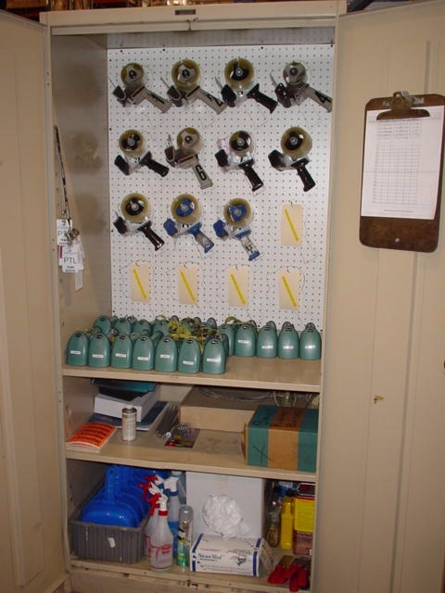
STORE - Organize
5S Straighten/Store
Organize everything that remains; make locations visible and self-explanatory
Designate storage locations

Slide 75
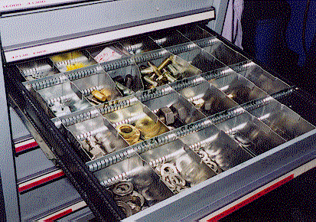
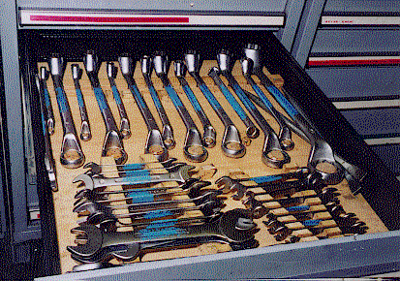
Visual Control
Storage makes auditing easier
5S Straighten/Store
“A place for everything and everything in
it’s place”

Slide 76
Visual Management
5S Straighten/Store
    VISUAL MANAGEMENT is key (see next section)
      Labeling
      Signage
      Floor markings, etc.

Slide 77
Visual Controls
5S Straighten/Store
1
2
3
4
5
6
7
8
9
10
Audio and
Visual Controls
Notes:
Here are some everyday examples of visual and audio controls.
(Talk through the examples on this slide as you emphasize that these tools are not only common, but essential for reasons of safety.)
These traffic devices were created by vehicle users to support safety.
It’s no different in the workplace. Visual and audio controls are tools of communication used by operators, supervisors and customers alike to ensure safety and timelines.
Proper labeling and signage support process improvement by making the workplace “talk” to you.

Slide 78
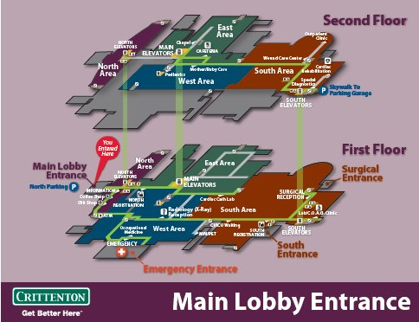
Visual Guides “You are here”
5S Straighten/Store

Slide 79
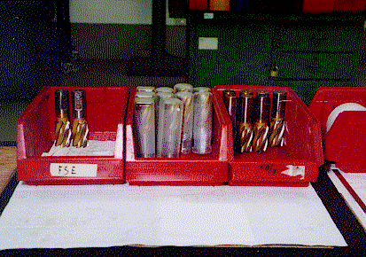
Use labels to identify items (1 of 2)
5S Straighten/Store
3/4”
1/2”
7/8”

Slide 80
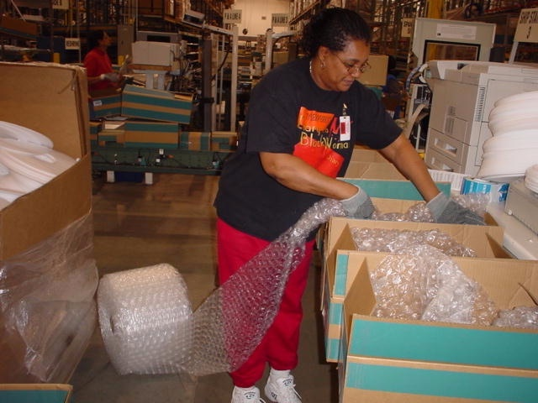
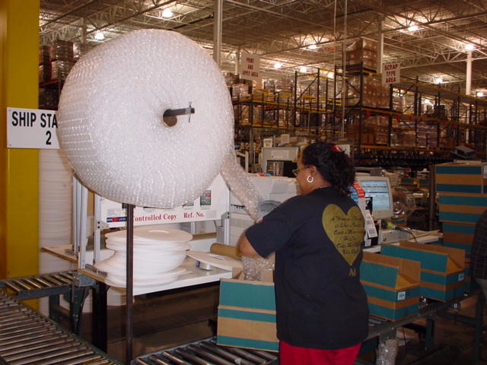
5S Straighten/Store
BEFORE
AFTER
Bubble wrap roll on floor – Have to bend and twist constantly to reach roll.
Unnecessary motion–Extra steps to reach roll
Unsafe condition – Trip hazard
Installed dispenser for easy access and reach
Improved ergonomics – no more bending and twisting
Safe work area

Slide 81
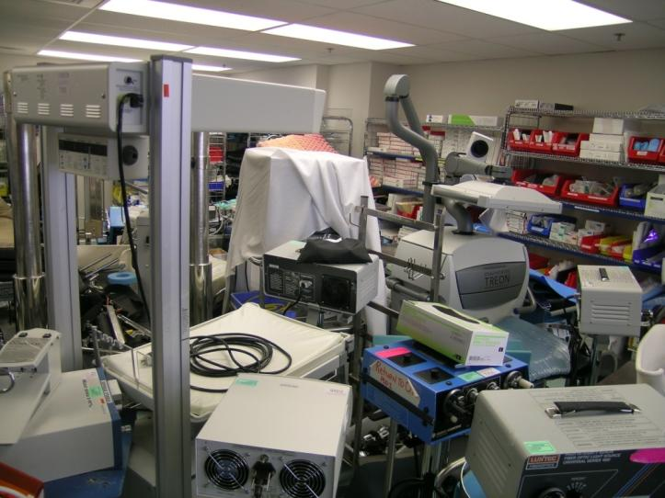
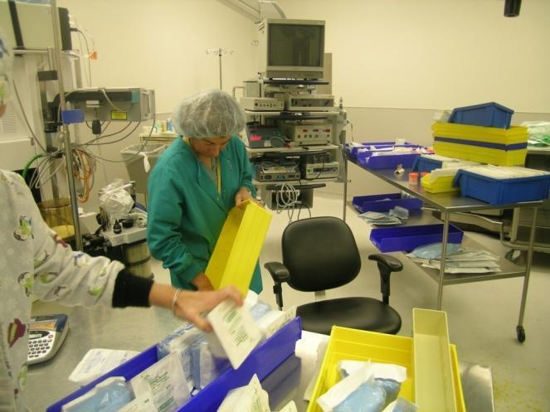
5S Straighten/Store
Identifying the Need for 5S and Waste Reduction
Do we need 5S? Can you identify any “waste”?

Slide 82
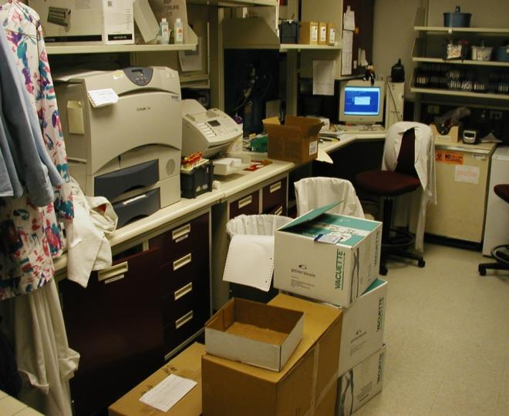
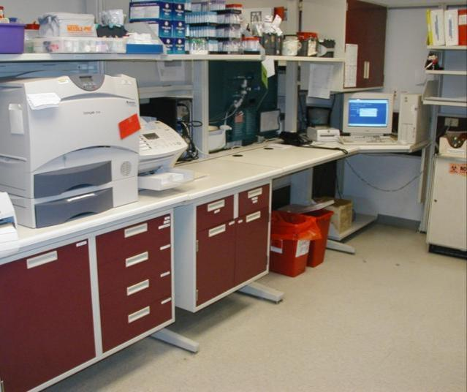
Laboratory
5S Straighten/Store
Before
After

Slide 83
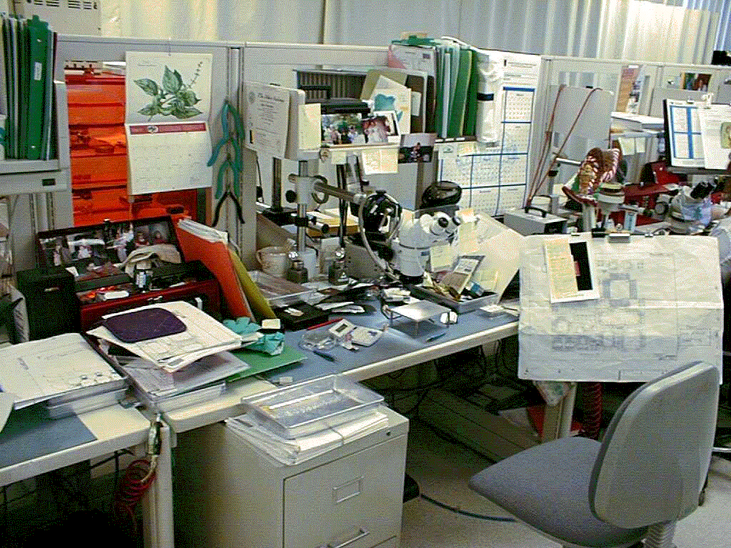
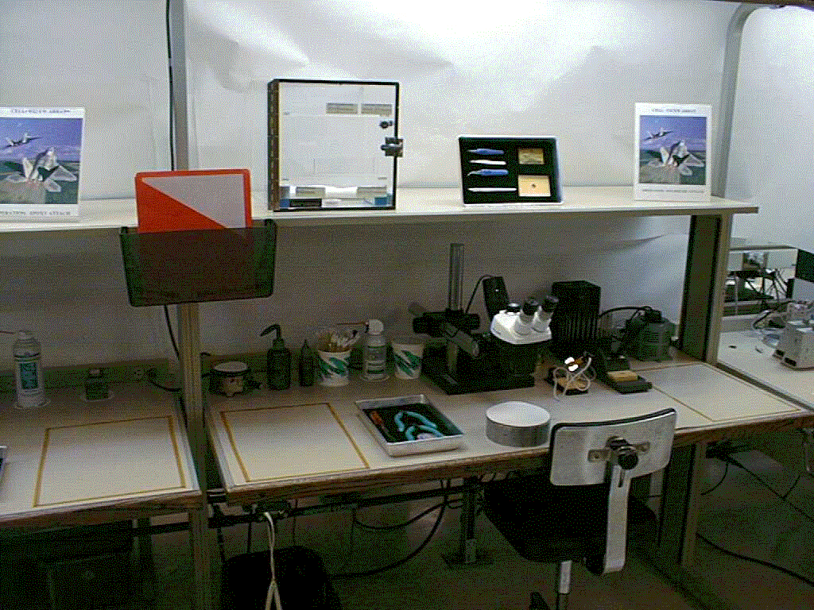
“Any” Workstation
5S Straighten/Store
Before
After
Create a Place for Everything, and Everything in Its Place
Notes:
1

Slide 84
5S
2
1
3
Try again?
In 15 seconds find all of the numbers from 1 – 36 -- IN ORDER.
Notes:
Basic instructions slide

Slide 85
11
7
3
2
4
5
8
1
6
9
10
12
25
30
27
26
13
14
28
16
29
18
15
17
31
23
36
35
24
33
21
32
22
20
34
19
Notes:
Here we have loosely put the numbers into groups of 6, but it is still very difficult to tell if anything is missing

Slide 86
better?
Still, What’s Missing?

Slide 87
11
7
5
3
2
1
4
8
6
9
12
10
25
30
27
26
28
13
14
18
29
16
17
15
35
36
23
24
33
32
21
22
20
31
19
Notes:
We’ve added an element of Color Coding/Visual Management. Still much better, but still slow to see if we have everything we need. This system alone would still require auditing to see if everything is there.

Slide 88
7
8
9
10
11
12
25
26
27
28
29
30
31
32
33
34
35
36
19
20
21
22
23
24
1
2
3
4
5
6
13
14
15
16
17
18
Notes:
Here again – the next “evolution” in our continuous improvement is far better than previous methods, but still not logical.

Slide 89
1
2
3
4
5
6
7
8
9
10
11
12
13
14
15
16
17
18
19
20
21
22
23
24
25
26
27
28
29
30
31
32
33
34
35
36
Notes:
Much more organized but still difficult to identify WHERE to put something for someone new. It would require a lot of explanation if these were items vs. the numbers – in other words, what is the method to the madness?

Slide 90
5S
2
1
3
Try again?
In 15 seconds find all of the numbers from 1 – 36 -- IN ORDER.
Notes:
Basic instructions slide

Slide 91
A
B
C
D
E
F
1
1
2
3
4
5
6
2
7
8
9
10
11
12
3
13
14
15
16
17
18
4
19
20
21
22
23
24
5
25
26
27
28
29
30
31
32
33
34
35
36
6
Notes:
Color Coded -- Sorted -- Labeled
There is an “address system” used here that makes it almost impossible to misplace things. See next slide – it also makes it immediately visible if something is missing.

Slide 92
How many did you get?

Slide 93
Easier?
How much time can you save or what can you learn about your organization with these principles?

Slide 94
38
77
22
64
61
58
45
27
3
28
15
2
6
55
54
42
63
68
47
8
74
36
71
7
32
9
40
20
11
51
73
31
43
67
76
16
13
41
14
46
Started with?
18
1
56
65
60
53
62
26
19
34
21
23
70
49
72
41
78
61
17
50
10
44
25
29
57
52
30
69
37
66
48
5
33
4
35
12
39
59
75
Notes:
Finally, show this slide again to show where we started – chaos – and where we ended up. Ask the group to overlay this concept onto their work area and imagine a place where they could find what they needed, when they needed it, without having to sift through a garbage heap-full of junk or non-utilized “stuff”. Explain the COST of keeping things “just in case.”

Slide 95
A
B
C
D
E
F
1
2
3
4
5
6
2
7
8
9
10
11
12
3
13
14
15
16
17
18
4
19
20
21
22
23
5
25
26
27
28
29
30
31
32
33
34
35
36
6
Notes:
Now we can readily identify WHAT is missing, and from WHERE…. There is no auditing necessary to quickly see if all items are there – THIS is how we truly achieve…. “Everything HAS a place and everything IN its place….”
See next slide as a reminder of our starting point…………. How long would it have taken you to determine if something was missing from that mess?!

Slide 96

5S
What is the COST of disorganization???
Notes:
Give examples of “one second” that is wasted in your company and think of how it could be eliminated. Make a “case” to present to your boss/co-workers for actually making the change.

Slide 97
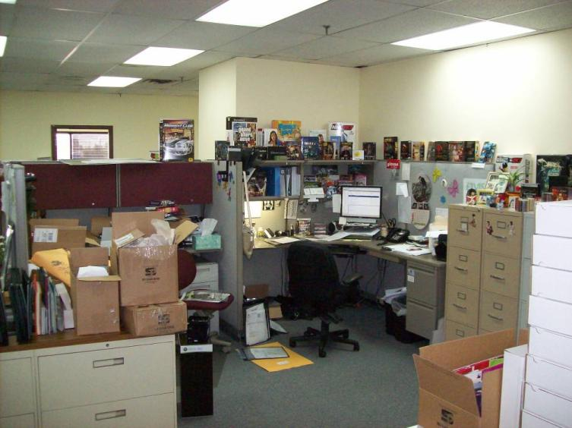
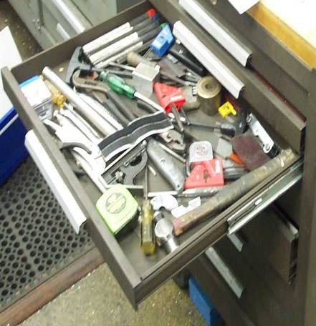
5S
Do you have areas in your company that look like this? Its just like the first slide of chaotic numbers!
Notes:
Basic instructions slide

Slide 98
SHINE - Cleanliness
5S Shine
“A clean workplace makes the unspoken statement that quality work is expected.”
Step 3

Slide 99
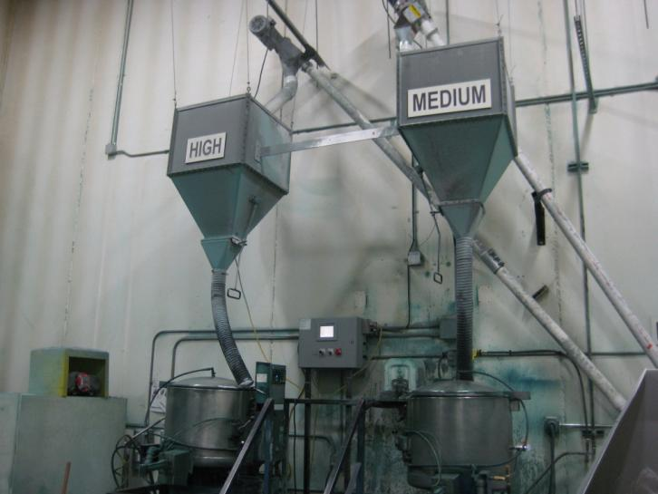
5S Shine
Cleaning is Inspection,
Inspection is Detection,
Detection is correction!

Slide 100
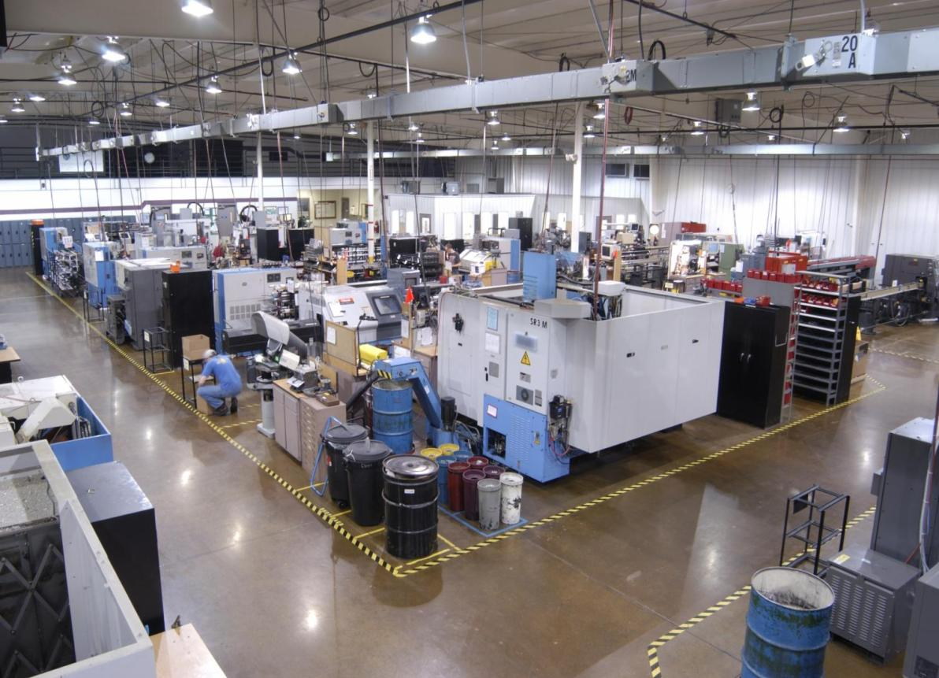
This is what “clean” looks like…
5S (‘Do’ Phase)
100
Notes:
This facility has an aggressive 5S program at all levels.

Slide 101
STANDARDIZE - Participation
5S Standardize
Good housekeeping habits should be everyone’s responsibility, including management and staff.
STANDARDS (expectations) must be set and visual.
Step 4

Slide 102
SUSTAIN – Self-discipline
5S Sustain
Sustain
Requires self-discipline
  Discipline is consistently working by the rules and standards of clearing, locating, and cleaning and
commitment from
everyone in the organization
“Inspect what you expect”
Step 5
102

Slide 103
Example: 5S Audit Scorecard
5S

Slide 104
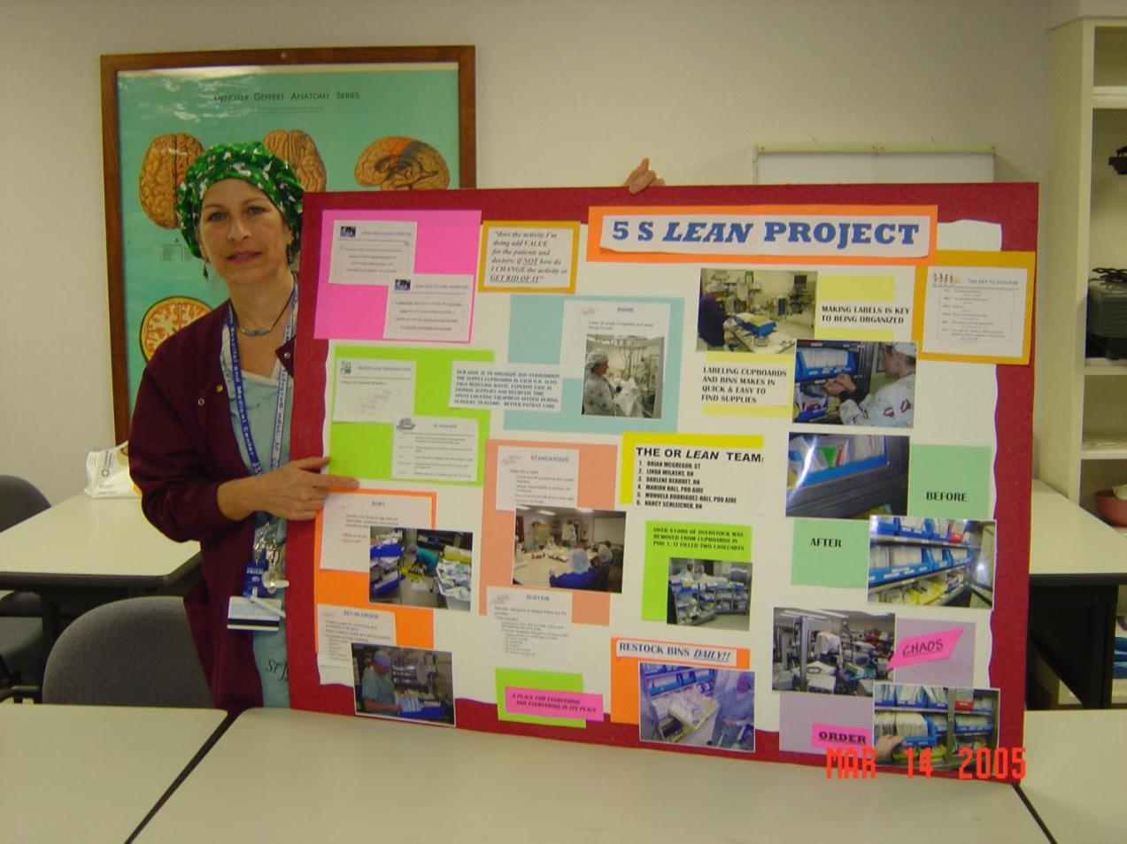
One way to show progress
All Lean projects should have some sort of display board or area, but 5S is the BEST way to show progress…. (Before & After)
Plan in advance to start this board and have it evolve as the project progresses.
104
Notes:
This was a nurse who did scrapbooking and volunteered to do the board. She had very limited supplies. I can only imagine how nice it would have been if she’d had more choices!!

Slide 105
5S
To Do Steps
To Maintain Steps
1) Sort (Sort through & Sort out)
Keep what’s needed -- eliminate what’s not…
2) Straighten (Set-in-Order & Set Limits)
Where shall we put it? How shall we store it?
3) Shine (and inspect through cleaning)
Clean it up and prepare to keep it clean.
4) Standardize (and share information)
Design and implement Visual Controls
Standardize tools and procedures
5) Sustain (Self-Discipline)
Train everyone to new standards
Audit system
Continue to improve

Slide 106
5S Where to Start?
Sustain
Where to start?
Typical companies are highly successful at the first 3 S’s…
Consider starting with system development?
  Who
  What
  When
  Where
  How much (time)
106

Slide 107
Agenda
Welcome and Introductions
MLC Overview
The History Of Lean
What Is Lean and how it differs
The 8 Wastes
Standard Work Exercise
Error Proofing
5S
Sustaining and Maintaining the Concepts
What will you do Monday?
Notes:
Standard Font: Arial, size 40 for title

Slide 108
Sustaining And Maintaining
Improving your process exercise
I need a Volunteer
I am going to improve your process!
Notes:
Standard Font: Arial, size 40 for title

Slide 109
Sustaining And Maintaining
Time to complete
# of Occurrences
WHY DID THE PRODUCTIVITY TANK?
Notes:
Standard Font: Arial, size 40 for title

Slide 110
Sustaining And Maintaining
It always gets worse before it gets better. Period.
Whatarewegonnadoaboutit!
Notes:
Standard Font: Arial, size 40 for title

Slide 111
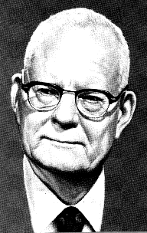
Sustaining And Maintaining
“Transformation in any organization will take place under a leader. It will not be spontaneous. A leader possesses knowledge, personality, and persuasive power.”
~ Dr. Deming
Notes:
Standard Font: Arial, size 40 for title

Slide 112
Sustaining And Maintaining
Help each other and not backstab
Continuous education
Positive reinforcement
Promoting the ‘right’ leaders
Coaching
Changing behaviors – find a way for success instead of failure
PDCA, PDCA, PDCA!
Notes:
Standard Font: Arial, size 40 for title

Slide 113
Sustaining And Maintaining
Sharing Our Experiences:
Give me examples of Learning Curve success stories, and failures!
Notes:
Standard Font: Arial, size 40 for title

Slide 114
Agenda
Welcome and Introductions
MLC Overview
The History Of Lean
What Is Lean and how it differs
The 8 Wastes
Standard Work Exercise
Error Proofing
5S
Sustaining and Maintaining the Concepts
What will you do Monday?
Notes:
Standard Font: Arial, size 40 for title

Slide 115
So, What Are You Going to Different on Monday

Slide 116
So, What Are You Going to Different on Monday
Your ideas?
Start with personal reflection (Do you believe?)
Organization assessment (large organization start with what you control).
Value Stream / Process Mapping (other discovery tools).
Pick an area and start PDCA cycle
Don’t wait! Get your Learn on!

Slide 117
What Are Your Takeaways and Questions?
The History Of Lean
What Is Lean and how it differs
The 8 Wastes
Standard Work Exercise
Error Proofing
5S
Sustaining and Maintaining the Concepts
Notes:
Standard Font: Arial, size 40 for title

Slide 118
Reflection
Everyone stand up and come to the front of the room and let’s discuss the training…
What went well | What should we change
Notes:
Standard Font: Arial, size 40 for title

