Slide 1
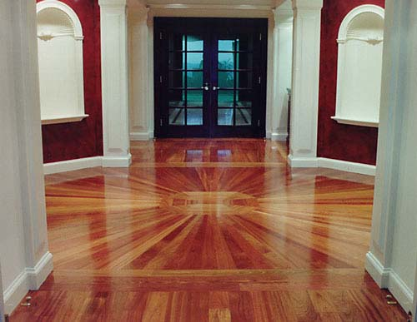
Schafer Hardwood Flooring: Increasing Glue Line Throughput
Rahul Seelam
Demmer Center - Lean Apprentice
Michigan State University - MBA 2013
Notes:
Introduce about myself
Rahul Seelam
MBA
6 months at the Demmer center
Introduce about the project
first project with the Demmer center
our objective was to increase throughput for one of their line
One request

Slide 2
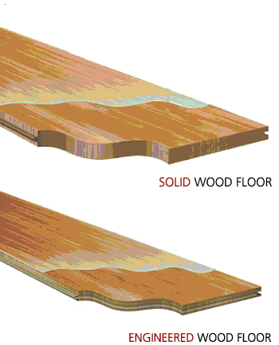
Schafer Hardwood Flooring
Privately owned
Products
Engineered
Solid
Locations
Tecumseh, MI
Troy, MI
Key customers
Builders and installers
Notes:
Before going into more details I would like to give an overview of the company
Schafer hardwood flooring is a privately owned compnay manufacturing hardwood floors
The main difference between these two floors is that the ep has three layers of different types of wood glued together and is relatively cheaper where s the sp is mainly made out of single piece of high quality wood.
Its manu loc is based in Tec MI where it has 50 employees working on producing these floors. It distribiutes

Slide 3
Agenda-A3
Theme
Background
Counter Measures
Current State
Goal
Effect Confirmation
Root Cause Analysis
Follow Up Actions
Notes:
In todyas agenda we will be using a standrar A3 report format to uncover the details of my project
Below are the steps for the A3 process which has it roots in the traditional PDCA cycle. A3 method of problem solving is introduced by Toyota
A3 is a paper size, typically 11″ x 17″. There are actually several A3-type paper sizes, and Toyota believes that when you structure your problem solving around 1 page of paper, then your thinking is focused and structured.

Slide 4
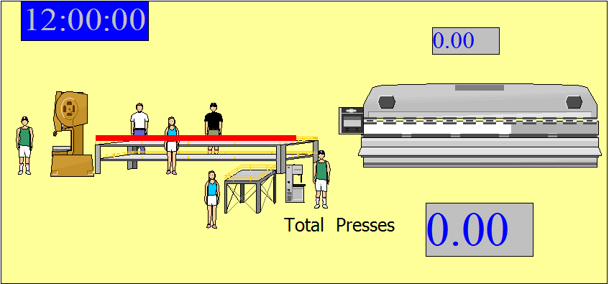
Theme: What Project?
Increase glue line throughput of engineered products
Notes:
As you saw in the previous slide, the first step in the process is identifying the theme.
To give an overview what this glue line is
Ripsaw line whe

Slide 5
Glue Line SIPOC
Suppliers | Inputs | Process | Outputs | Customers
Rip Saw Line Glue Suppliers | Veneers Cherry Cores Glue |  | Pressed Board Units | End Match Line
“Gluer”
Glue Veneers
“Stackers”
Lay Veneers
“Card dealer”
Install Cores
Press

Slide 6
A3
Theme: Increase glue line throughput of engineered products
Background
Counter Measures
Current State
Goal
Effect Confirmation
Root Cause Analysis
Follow Up Actions

Slide 7
Background: What Purpose?
Demand not met
Glue line is the bottleneck process
Production costs are increasing

Slide 8
A3
Theme: Increase glue line throughput of engineered products
Background: 1) Excess demand
2) Bottleneck 3) Increasing costs
Counter Measures
Current State
Goal
Effect Confirmation
Root Cause Analysis
Follow Up Actions

Slide 9
Current State

Slide 10
Current State
Press could produce 36 units
Producing only 16 units
Making only 50% of the potential revenue on engineered products

Slide 11
A3
Theme: Increase glue line throughput of engineered products
Background: 1) Excess demand
2) Bottleneck 3) Increasing costs
Counter Measures
Current State:1) Average throughput per day is 16 2) Less than 50% capacity utilization
Goal
Effect Confirmation
Root Cause Analysis
Follow Up Actions

Slide 12
Goal
To maximize throughput while maintaining required quality and safety standards

Slide 13
A3
Theme: Increase glue line throughput of engineered products
Background: 1) Excess demand
2) Bottleneck 3) Increasing costs
Counter Measures
Current State:1) Average throughput rate is 16 units 2) Less than 50% capacity utilization
Goal: Maximize press throughput while maintaining quality and safety
Effect Confirmation
Root Cause Analysis
Follow Up Actions

Slide 14
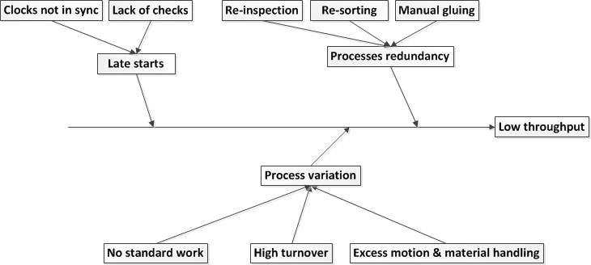
Root Cause Analysis

Slide 15
A3
Theme: Increase glue line throughput of engineered products
Background: 1) Excess demand
2) Bottleneck 3) Increasing costs
Counter Measures
Current State:1) Average throughput rate is 16 units 2) Less than 50% capacity utilization
Goal: Maximize press throughput while maintaining quality and safety
Effect Confirmation
Root Cause Analysis
Follow Up Actions

Slide 16
Counter Measures
Cause | Counter measure
Process variation | Line balanced work elements
 | “Water Spider” role
 | Cross trained continuous work force
Late starts | Team leader start check list
 | Synchronized clocks
Process redundancy | Material preparation away from the area and delivered as kits

Slide 17
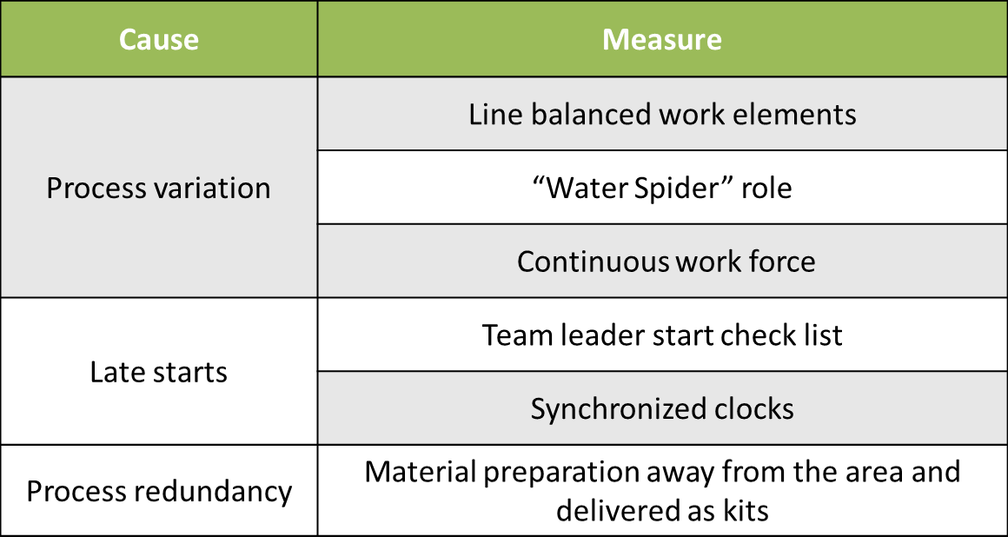
A3
Theme: Increase glue line throughput of engineered products
Background: 1) Excess demand
2) Bottleneck 3) Increasing costs
Counter Measures:
Current State:1) Average throughput rate is 16 units 2) Less than 50% capacity utilization
Goal: Maximize press throughput while maintaining quality and safety
Effect Confirmation
Root Cause Analysis
Follow Up Actions

Slide 18
Effect Confirmation
Trial Days | Throughput | Time | Throughput increase | Safety Incidents
First | 23 | 7 hours | 75% | 0
Second | 30 | 8 hours | 87% | 0
Third | 26 | 8 hours | 75% | 1
Historic average throughput is 16 units

Slide 19
A3
Theme: Increase glue line throughput of engineered products
Background: 1) Excess demand
2) Bottleneck 3) Increasing costs
Counter Measures:
Current State:1) Average throughput rate is 16 units 2) Less than 50% capacity utilization
Goal: Maximize press throughput while maintaining quality and safety
Effect Confirmation
Root Cause Analysis
Follow Up Actions

Slide 20
Unresolved Issues / Follow Up Actions
Issue | Follow up action
Manual Gluing | Engineering Solution needed
Sustainability | Employee recognition and empowerment
 | New production and safety standards

Slide 21
Completed A3
Theme: Increase glue line throughput of engineered products
Background: 1) Excess demand
2) Bottleneck 3) Increasing costs
Counter Measures:
Current State:1) Average throughput rate is 16 units 2) Less than 50% capacity utilization
Goal: Maximize press throughput while maintaining quality and safety
Effect Confirmation
Root Cause Analysis
Follow Up Actions

