Slide 1

Michigan Lean Consortium
Lean 101
Dave Kippen
Jerry Browne

Slide 2
SAFETY MESSAGE
Welcome!
Fire exits
In case of fire, please walk to the nearest exit.
Unsafe act or condition
If you see an unsafe act or condition, please notify the instructor

Slide 3
Agenda
Welcome and MLC Overview
Introductions
The History Of Lean
What Is Lean and how it differs
The 8 Wastes
Standard Work Exercise
SQDC
5S
Sustaining and Maintaining the Concepts
What will you do Monday?
Notes:
Standard Font: Arial, size 40 for title

Slide 4

2015 Overview

Slide 5

Our New Vision/Mission
Develop and support lean systems thinkers to transform Michigan’s organizations and economy.
Notes:
Our mission is to provide fun and educational lean Offer diverse educational programs and workshops on lean topics that promote sharing of innovative practices, networking and fostering a sustainable advantage for Michigan’s public, private and educational organizations that leave you with the knowledge to improve your workplace.

Slide 6
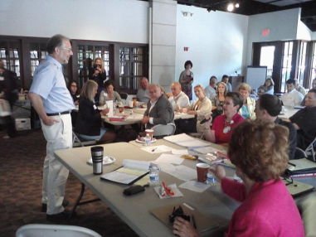
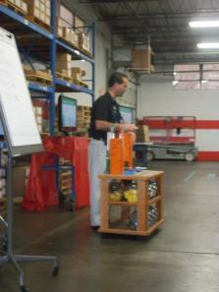

What We Do
Knowledge Sharing Events
Training
Expert Speakers
Leadership Panels
Knowledge-Sharing
Networking
Lean Leadership Training with Dr. Jeffrey Liker
Benchmarking Visits
“Go and See” learning
Front line and Leadership Q&A
Micron Manufacturing Benchmarking Visit
Notes:
Add pics from events

Slide 7
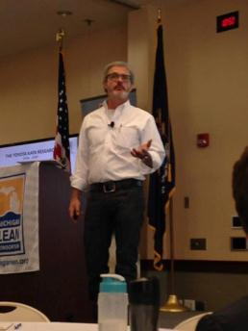
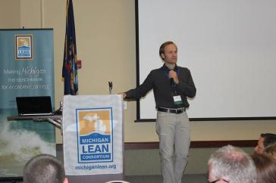
What We Do
Annual Conference
  Keynote speakers
  Breakout sessions
  Industry roundtables
  In-depth training
Mike Rother
Lean Projects
State of Michigan
City of Detroit
Center for Financial Planning
Michigan Lt. Governor Calley
Notes:
Add pics from events

Slide 8
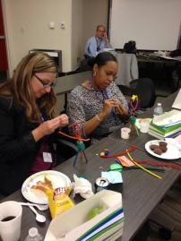
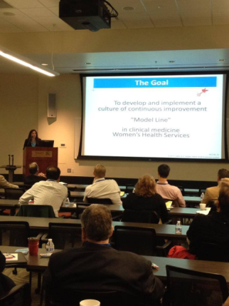
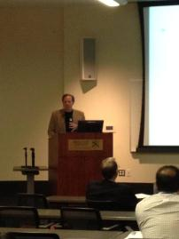
What We Do
Annual Healthcare Symposium
  Keynote speakers
  Breakout sessions
Notes:
Add pics from events

Slide 9











Who We Are
Jim Manley, Chair
Dennis Sergent,
Vice Chair
Dave Kippen
Mike Taubitz, Secretary
Debra Levantrosser,
Ad Hoc Member
Rich Wolin,
Ad Hoc Member
Betsy Williams
G.S. Clarke,
President
Eric Walters
Jessica Jannaman
Current MLC Board of Directors
Formed in 2008
Non-profit, all volunteer run by committees
Our vision
All public, private and educational organizations in Michigan
are at the benchmark level of efficiency and competitiveness.
  7

Slide 10
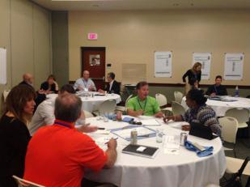


Our Members
500+ and growing
All across Michigan
Novice to seasoned practitioners
Health care, education, manufacturing, energy, consulting and more
Both individual and organizational membership

Slide 11


Join Us!
Affordable
Access to organizations, leaders and best practices
Monthly Events & Annual Conference
MLC-sponsored Projects
Networking

Slide 12


Get Involved!
Visit www.MichiganLean.org
Connect on LinkedIn and Twitter
Like us on Facebook
Join a Committee
Suggest Event Topics
Notes:
I am working on updating and improving our website, so please feel free to give your suggestions today or anytime via email.

Slide 13
Upcoming Events
  June 4: Lean 102 (Superior National)
  Hancock
  June 5: Lean Assessments
  Houghton
  June 12: Toyota Kata (REGISTRATION FULL)
  West Olive
  August 12-14: Annual Conference
  Traverse City
  September: Lean 103 (Superior National)
  Hancock
  Copper County Local Lean Group
Please let us know if you have ideas for an event or have an interest to be a host.
Email: register@michiganlean.org

Slide 14
Reminders
  Please complete the survey that will be emailed to you! If you complete the survey you may receive a Certificate of Attendance.
  THANK YOU Your support and feedback helps us to continually improve!

Slide 15



Thank You To Today’s Sponsors!

Slide 16
Agenda
Welcome and MLC Overview
Introductions
The History Of Lean
What Is Lean and how it differs
The 8 Wastes
Standard Work Exercise
SQDC
5S
Sustaining and Maintaining the Concepts
What will you do Monday?
Notes:
Standard Font: Arial, size 40 for title

Slide 17
Introductions
Name
Title/Job/Time on the job
Knowledge or/Experience in Lean?
Expectations for the class
Notes:
RICTA
Reach
Influence
Cause to act
Afflict the comfortable
Comfort the afflicted

Slide 18
Agenda
Welcome and Introductions
MLC Overview
The History Of Lean
What Is Lean and how it differs
The 8 Wastes
Standard Work Exercise
Error Proofing
5S
Sustaining and Maintaining the Concepts
What will you do Monday?
Notes:
Standard Font: Arial, size 40 for title

Slide 19
Bronze Body of Knowledge Materials
Chapter 1 Lean Production Simplified
Introduction Lean Thinking

Slide 20
History of Lean
116 years ago you want to buy a car. What is the production system?
Pros?
Cons?
Enter Henry Ford. What was the system he made popular?
Pros?
Cons?
Notes:
Use flip charts to record responses.
Craft manufacturing:
PROS
High quality
One piece flow
Unique products
Creativity and craftsmanship
Workers as an asset
Responsive and flexible
Entrepreneurial
Niche
CONS
Nothing standard, everything custom
High cost
Everything unique, product repair costs high
Production Line/Mass Manufacturing:
PROS
Increased uniformity
Reduced variability
Fast delivery
Lower cost
Higher profit margins
Products easier to repair
Low Inventory
CONS
Lower quality
Rigid production facilities
Higher initial capital investment
Monotonous and repetitive jobs

Slide 21
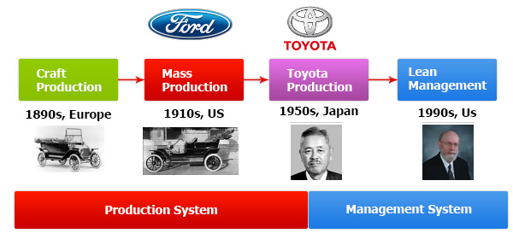
History of Lean
Notes:
The PROS of both systems flow into MANAGEMENT SYSTEMS such as TPS and Lean management
Along comes Eiji Toyoda and Taiichi Ohno…
The Toyota Production System tries to integrate low inventory, workers as an asset, high quality, fast delivery, low cost…
LEAN!
Talk about what a MANAGEMENT SYSTEM is:
Alignment of goals - strategic
Disciplined adherence to process – Discipline by all, measured and monitored as close to moment-to-moment as possible
Standard Work – Defined, monitored, and improved
Visual Management – Where are we headed, where are we now, what is the gap, are we ahead or behind
Coaching for Continuous Improvement – Developing capability

Slide 22
Agenda
Welcome and MLC Overview
Introductions
The History Of Lean
What Is Lean and how it differs
The 8 Wastes
Standard Work Exercise
SQDC
5S
Sustaining and Maintaining the Concepts
What will you do Monday?
Notes:
Standard Font: Arial, size 40 for title

Slide 23
Bronze Body of Knowledge Materials
Chapter 2 Lean Production Simplified
Chapter 1 Lean Thinking
Chapters 1,2 Gemba Kaizen

Slide 24
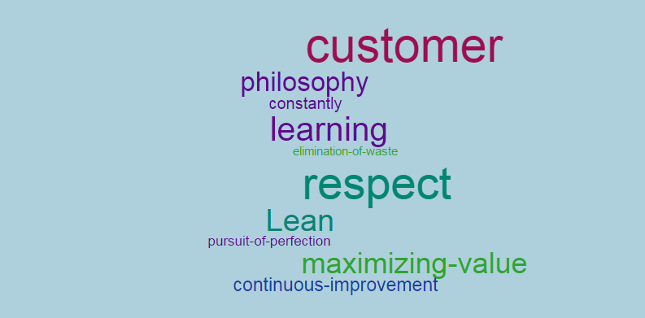
What is lean?
Notes:
Lean is both an intentional model for creating and sustaining an environment where continuous improvement is the norm, and a set of processes, methods, and tools for improvement.
A philosophy of continuous improvement and learning that respectfully involves all employees, who constantly pursue the elimination of waste and the reduction of variability; towards the pursuit of perfection, defined as maximizing value for our customers.

Slide 26
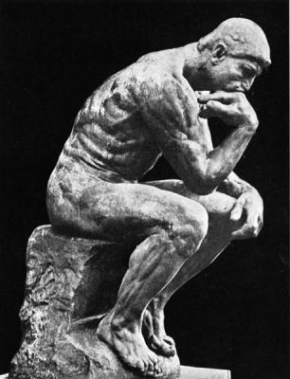
What is lean?
Lean = Lean Thinking
It is about a mindset,
a philosophy,
a culture…
Notes:
“In short, Lean thinking is Lean, because it provides a way to do more and more with less and less -- less human effort, less equipment, less time, and less space -- while coming closer and closer to providing customers with exactly what they want.”
Womack, J.P., & Jones, D.T. (2003). Lean Thinking. New York: Free Press, p.15.
Lean is a “Thinking Business System”
Right Thinking = Right Behavior
Right Behavior = Right Results
Its about getting the “Thinking” right

Slide 27
Overview and Key Concepts
Being individually accountable at all levels
Management exists to support the workforce
Systematically, and continuously, taking out waste or of every aspect of a company’s operation
Challenging the tradition and status quo
Asking questions to Learn
Notes:
Management supporting the workforce = SERVANT LEADERSHIP

Slide 28
Overview and Key Concepts
Empowering all staff to make improvements to their processes and workplace
Helping and not criticizing
Aiming for perfection, but accepting excellence along the way
Practicing deep forced reflection
True teamwork

Slide 29
Overview and Key Concepts
Focused on small, incremental, sustainable changes
Continuous – becomes a way of life
No blame culture and freedom to fail
Change and action-oriented
Operational performance become fit, athletic, strong, agile
Notes:
FLIPCHART EXERCISE:
If you had a Lean organization….
What would it feel like, look like?

Slide 30


PDCA
Plan
(and Design)
Do
(Implement)
Check
(Evaluate/Audit)
Act
(Assess or re-assess)
Standardize
Lean
Certificate
Programs
Oakland University Lean Diversification Program
30
Notes:
A = Act or Adjust
Also, PDSA
S = Study

Slide 31
The Plan-Do-Check-Act Cycle
The Plan-Do-Check-Act (PDCA) cycle is the Lean operating framework — the methodology for implementing improvements (Kaizen).
The PDCA cycle was first developed in the 1930s by Walter Shewhart, the Bell Telephone physicist often called the father of statistical quality control.
PDCA was brought to Japan in the 1950s by W. Edwards Deming; in Japan, it’s known as the Deming cycle.
Notes:
The Plan-Do-Check-Act (PDCA) cycle is the Lean operating framework — the methodology for implementing Kaizen.
The PDCA cycle was first developed in the 1930s by Walter Shewhart, the Bell Telephone physicist often call the father of statistical quality control.
PDCA was brought to Japan in the 1950s by W. Edwards Deming; in Japan, it’s known as the Deming cycle. Alternatively, it is referred to as Plan-Do-Study-Act (PDSA).
Here’s what the four parts of the PDCA (or PDSA) acronym mean:
Plan: Create a plan for change, identifying specifically what you want to change. Define the steps you need to make the change, and predict the results of the change.
Do: Carry out the plan in a trial or test environment, on a small scale, under controlled conditions.
Check or study: Examine the results of your trial. Verify that you’ve improved the process. If you have, consider implementing it on a broader scale; if you haven’t, go back and try again.
Act: Implement the changes you’ve verified on a broader scale. Update the standard operating procedures.

Slide 32
PDCA Gets Personal
Running Errands After Work
Plan
  Drive home from work and think about what to buy
Do
  Go to store
Check
  Call your significant other to see if you forgot something
Act
  Pick-up the three items you promised not to forget

Slide 33
PDCA Gets Personal
Jaywalking
Plan
  Waiting for long light with no visible traffic, you decide to jaywalk
Do
  Begin crossing the street
Check
  You see a car make a RH turn onto the street, coming at you
Act
  Stop, back-up or speed up…..

Slide 34
The Plan-Do-Check-Act Cycle
Plan
  Define the Gap
    Determine Current Condition
    Set Goal
  Perform Root Cause Analysis on Gap
  Develop Countermeasure(s) and Action Plan for Root Cause(s)
Do
  Implement Countermeasures
    Consider safety in all actions
Check
  Evaluate the Effects of the Countermeasures
Act
  Confirm Improvement or Return to Plan
  If Confirmed, Make Adjustments, Standardize, Document

Slide 35
Problem Solving
Plan
Do
Check
Act
Improvement
Standard
Time

Slide 36
How Lean Differs
Mental Models
LEAN APPROACH TO MANAGEMENT
TRADITIONAL MANAGEMENT STYLE
Notes:
AFFINITY DIAGRAM EXERCISE
LEAN
Ask
Lead
Train/ Educate
Understand All Players
Vertical & Horizontal Alignment
Listen
Share in Goal Setting
Empower Others
Teams (Team spirit)
TRADITIONAL
Tell
Direct
Autocratic
Dictatorial
Communication Top-Down
Use Authority
Impose Goals
Limit Performance
Individuals (“Me” theory)
Traditional: Improve system (disregarding all of the types of waste in the process).
Lean: Improve system by 1) Eliminating waste and 2) Improving current processes.
Traditional: Management is the primary driver of change.
Lean: Everyone is empowered, trained in the principles of lean and encouraged to look for ways to improve processes.
Traditional: If a process is working (if it ain't broke) don't fix it.
Lean: Always look for ways to improve processes
Traditional: Problems are viewed as just that, problems.
Lean: Problems are viewed as opportunities for improvement often through root cause analysis.
Traditional: Standardized work (people performing the same task the same way) only exists in documents like SOPs, rarely in reality.
Lean: Everyone performs the same task the exact same way until a better way is discovered; then everyone performs the task the new and improved way.
Traditional: Focuses on training and relies on people to not make mistakes.
Lean: Focuses on building processes that are error proofed (a person cannot make a mistake or it would be difficult to do so).
Traditional: Systems thinking (views the organization as a whole), often ignoring or unable to see the enormous opportunities for improvement.
Lean: Views the organization as a series of interrelated processes that can and should be improved.

Slide 37
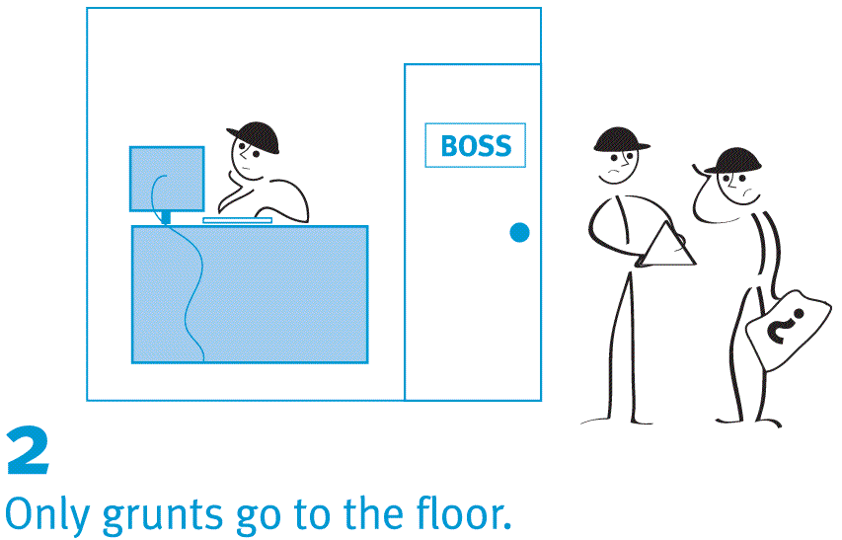
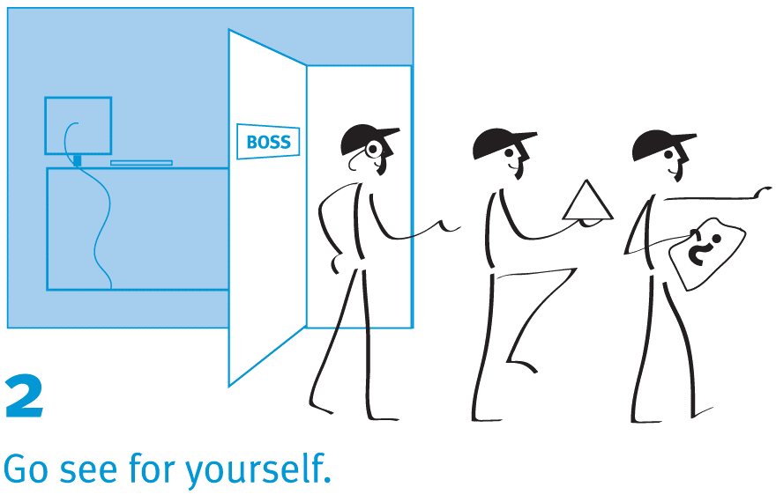
Lean Mental Models
Conventional
Lean
Notes:
Theresa
Lean principle, concept, tool, technique = Gemba Walks, Respect for People
Everyday Challenge = Motivation, Morale
Supervisory Skill to improve = Involving Employees in changes or decisions that will affect them, Encouraging Open Communication
CONVENTIONAL SCRIPT (Leader = Dictator)
Employee: Well, we have a problem with the widget press again. I guess I’ll have to go see the Boss. (walk over and knock on boss’ door)
Boss: Who’s there
Employee: It’s the Widget Press Operator. I need your help in figuring out a problem!
Boss: Come in. Now tell me, what’s the problem.
Employee: Every time I press the go button, the press malfunctions and it spits out two widgets instead of just one.
Boss: Go back and unplug it, wait 60 seconds, and plug it back in again. If it still malfunctions, come back and see me and I’ll tell you what else you might be able to try.
LEAN SCRIPT (Leader = Teacher)
Employee: Well, we have a problem with the widget press again. I guess I’ll have to go see the Boss. (walk over and knock on boss’ door)
Boss: Who’s there
Employee: It’s the Widget Press Operator. I need your help in figuring out a problem!
Boss: OK, let’s go and see what’s actually happening. We can figure this out together on the shop floor.

Slide 38
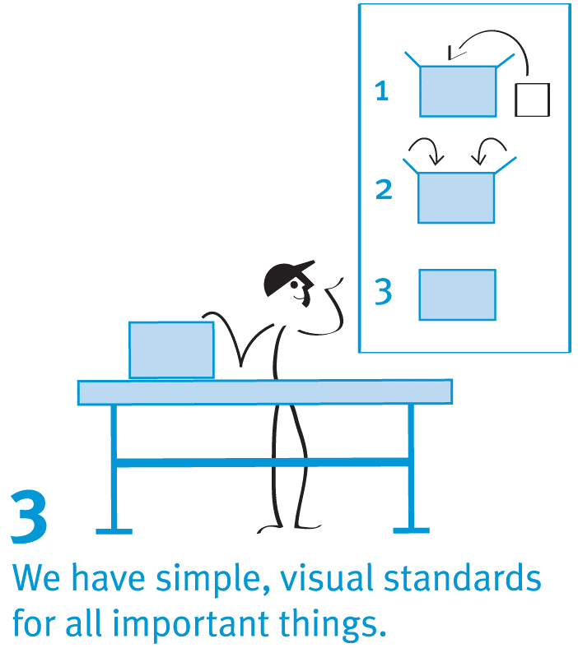
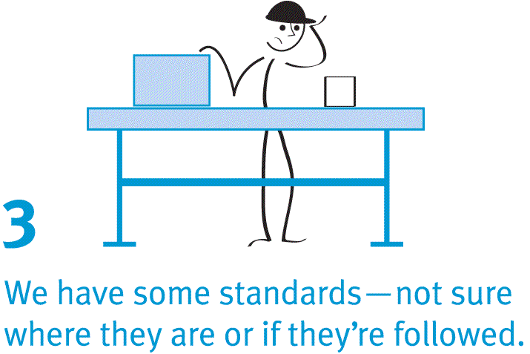
Lean Mental Models
Conventional
Lean
Notes:
Theresa
Lean principle, concept, tool, technique = Standard Work, Visual Controls
Everyday Challenge = Managing Performance, Communication
Supervisory Skill to improve = Avoiding micromanaging

Slide 39
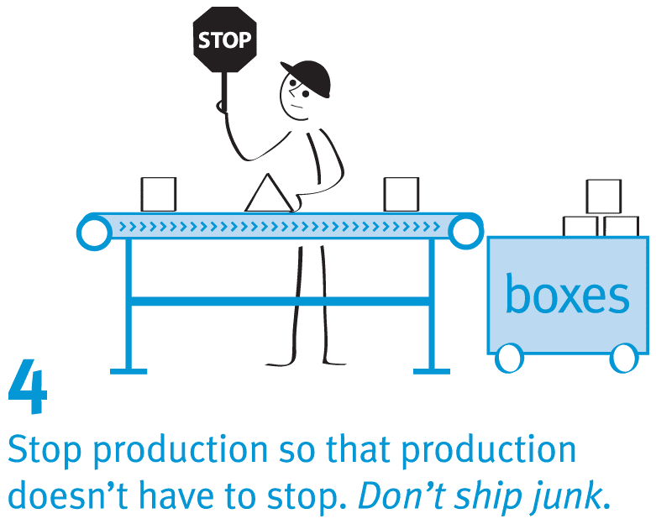
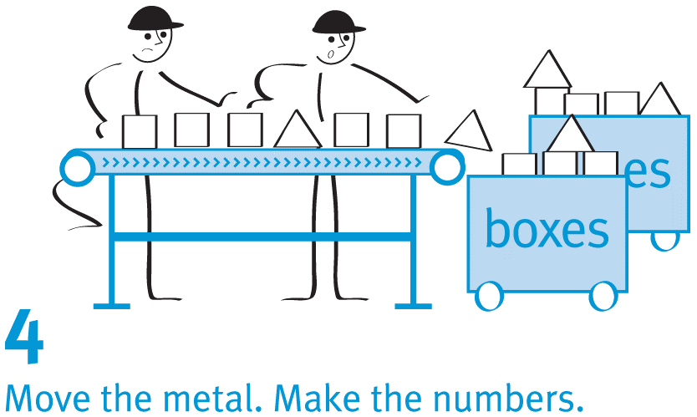
Lean Mental Models
Conventional
Lean
Notes:
Theresa
Lean principle, concept, tool, technique = Quality at the Source, Respect for People
Everyday Challenge = Managing Performance, Communication
Supervisory Skill to improve = Encouraging Open Communication, Committing to changing the things you can change, Treating everyone equally and with Respect
CONVENTIONAL SCRIPT (Move the metal/Make the Numbers)
Employee #1: (take form from pile in inbox) OK, let’s review this form. Oh, I see that this doesn’t have the required two-deep signatures………but that’s not really my problem. I have a lot of papers to process and I don’t have time to run around getting signatures. I’ll just pass this on to payroll.
Employee #2: (reviewing paper passed along from employee #1) Darn, this doesn’t have the required two-deep signatures. Now I have to send it back to the department. They’ll miss the processing deadline and now the employee will have to wait to get paid. If only we had caught this error earlier!
LEAN SCRIPT (Stop production so that production doesn’t stop)
Employee #1: (take form from pile in inbox) OK, let’s review this form. Oh, I see that this doesn’t have the required two-deep signatures. (Picks up phone and dials a phone number).
Hi Sue, this is Cindy. I just noticed that this form you submitted today doesn’t have the required two-deep signatures. How can we get Dr. Walker’s signature on it so we can get it to payroll before the deadline? Oh, you’ll come over and pick it up? Great, thanks Sue.

Slide 40
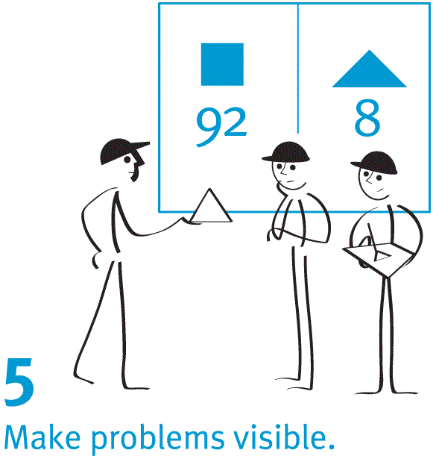
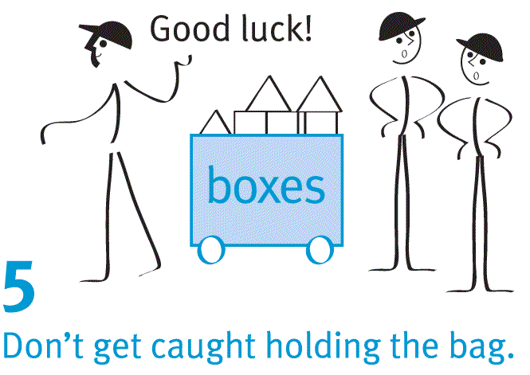
Lean Mental Models
Conventional
Lean
Notes:
Theresa
Lean principle, concept, tool, technique = Quality at the Source, Visual Work place
Everyday Challenge = Motivation, Communication, Priorities, Respect
Supervisory Skill to improve = Encouraging Open Communication, Involving employees in changes or decisions that will affect them

Slide 41
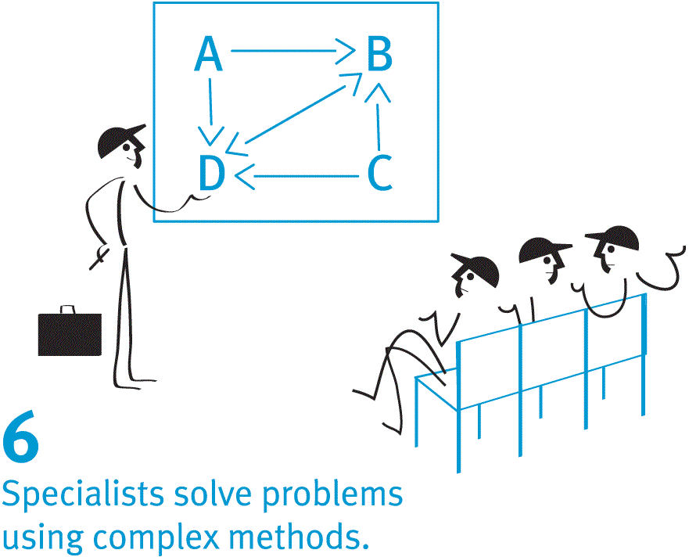
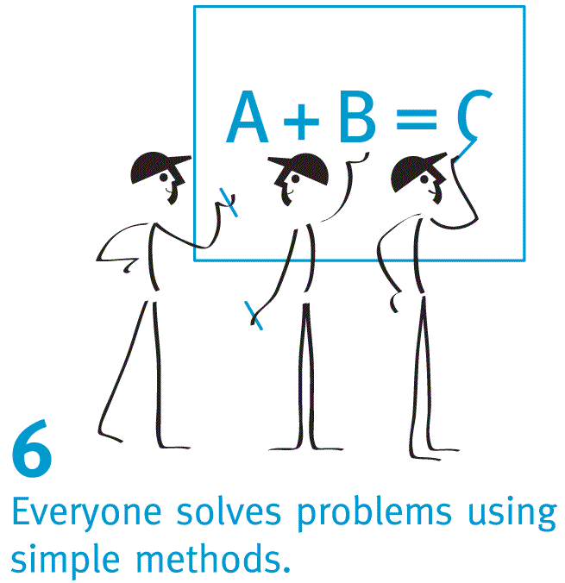
Lean Mental Models
Conventional
Lean
Notes:
Lean principle, concept, tool, technique = Respect for People, 4-step problem solving process/scientific method, cross-functional teams
Everyday Challenge = Motivation, Managing Performance, Communication, Morale, Respect
Supervisory Skill to improve = Encouraging Open Communication, Involving employees in changes or decisions that will affect them, committing to changing the things you can change, avoiding micromanaging, treating everyone equally and with respect
CONVENTIONAL SCRIPT (Specialists solve problems using complex methods)
Boss: OK group, I’ve been studying the data and by using our new software I’ve come up with the steps you need to take to reduce our scrap rate on the widget line.
LEAN SCRIPT (Everyone solves problems using simple methods)
Boss: OK group. As you can see by our leading indicators, we’ve experienced a spike in scrap on the widget line. Let’s review the data together, and then see if we can discover the root cause of this problem. I’m sure that together we can figure out a countermeasure that we can experiment with to reduce that scrap rate.

Slide 42
How Lean Differs?
Lean | Traditional
Business Model | Business Plan
Hypothesis-driven | Implementation-driven
Strategy
Notes:
Hypothesis is formed in the Planning stage of PDCA
Business Model if based on guiding principles and the thinking behind decisions
A business plan is more rigid and sequential

Slide 43
How Lean Differs?
Lean | Traditional
Customer Development | Product Management
Get out of the office and test hypothesis | Prepare offerings for market following a linear, stet-by-step plan
New-Product Process
Notes:
Value determined by the customer
Rapid experimentation

Slide 44
How Lean Differs?
Lean | Traditional
Cross-functional company and customer development teams | Departments by function
Hire for learning, nimbleness, and speed | Hire for experience and ability to execute
Organization
Notes:
Foundational – respect for people

Slide 45
How Lean Differs?
Lean | Traditional
Metrics that Matter | Accounting
Customer acquisition cost, lifetime customer value, churn, viral-ness | Income statement, balance sheet, cash flow statement
Financial Reporting
Notes:
Well-considered metrics as leading indicators

Slide 46
How Lean Differs?
Lean | Traditional
Expected | Exception
Fix by iterating on ideas and pivoting away from ones that don’t work | Fix by firing executives
Failure
Notes:
Fail your way to excellence
VERY cultural

Slide 47
How Lean Differs?
Lean | Traditional
Rapid | Measured
Operates on good-enough data | Operates on complete data
Speed
Notes:
Paralysis by Analysis

Slide 48
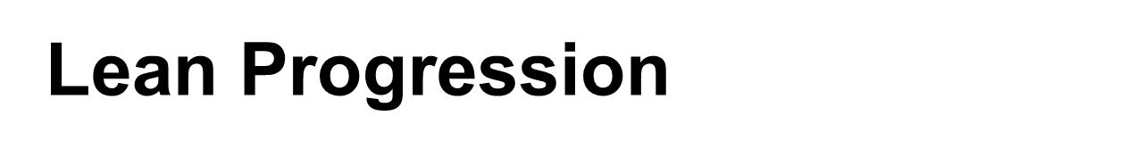
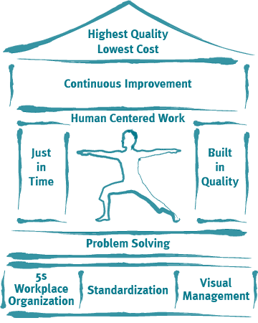
Notes:
Organizational Lean Progression – Future State

Slide 49
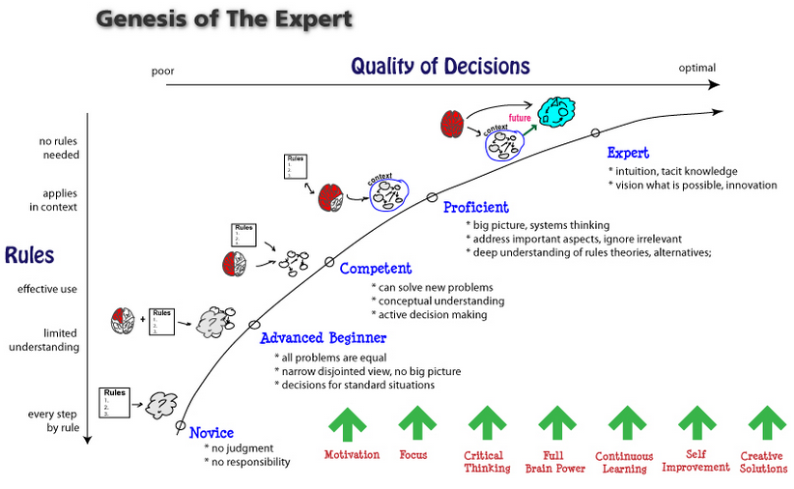
Notes:
Personal/Individual Lean Progression
Fixed State – Being Lean
Continuous Change – Becoming Lean
Set of Tools – Doing Lean
Lean Philosophy – Lean Thinking

Slide 50
Toyota’s Key to Lean Culture
Be anxious Always doubt your assumptions
Intellectual humility
Never think you are okay
Lean Culture
Be Anxious
Intellectual Humility
The 5 Why’s
Take Responsibility
Evolution Requires
Evolution
Evolution
Is an ongoing project
pursued at a deep
level
Evolution requires
Trial and error,
challenge and failure
Take responsibility
Do not blame circumstances for failures
SOURCE: http://www.coe.montana.edu/i e/faculty/sobek/ime458/BR/Sp02/partainBR.htm.
Ask why 5 times
To get to the root of the problem
Oakland University Lean Diversification Program
50
Notes:
Toyota’s key to Lean culture includes the following elements. Lean culture can be defined as cultivating human activity and the symbolic structures that give such activity significance.

Slide 51

What is Lean?
Being a coach at all levels of the organization is part of the uniqueness of lean.
What are some attributes of a good coach?
What do you think of when you hear “Coach”?
Notes:
Ask the participants to write down a few responses to these questions.
Write the word “Coach” on the flipchart
Have someone be the scribe
Have someone prompt the questions to the crowd
Record the responses on the sheet
Examples to get things moving:
Helping someone succeed
Helping develop skills
Probing questions to promote thinking and development
Mentoring
Giving advice
Active Listening
Seizing learning opportunities
Lean Leadership
Toyota Kata

Slide 52
Coaching
An ongoing approach that enables individuals to achieve their full potential.
A process that enables learning and development to occur and thus performance to improve.
A training or development process via which an individual is supported while achieving a specific personal or professional competence result or goal.
Notes:
I still need to improve this section of coaching
Lean Leadership
Toyota Kata

Slide 53
Lean Culture | A Great Leader | A Poor Leader
All about… | Managed Change | Stability without improvement
Approach | Sets direction & trusts the people | Plans/directs all details
Attitude | Proactive | Reactive
Beliefs | What is right? | Being right
Blame | Takes | Finger points
Conflict | Uses it for growth | Avoids or buries it
Credit | Gives | Takes
Decision Making | Facilitates consensus decisions | Makes decisions for the group
Direction | New, better ways | “If it ain’t broke, don’t fix it.”
Focus | On the Customer | Making the numbers look good
Goals | Long-term strategies | Short-term (looking good)
Culture | Shapes and grows it | Squashes it
Persuades people by | Selling | Telling
Problem Solving | Let’s fix it right (root cause). | Fire-fighting, band-aid fixes
Resource | “I am your resource.” | “You are my resource.”
They Have | Followers | Subordinates
Wants | Achievement | Results
Why should you…? | Shows the value of change | “You’re being paid to do what I say.”
Notes:
This is a fairly self-explanatory list of attributes that make up the difference between a good and poor leader. In a nutshell, the good leader is focused on doing whatever he/she can to make everyone else look good and to help them grow as people and employees, versus a more self-centered view that looks at all accomplishments as proprietary and all failures as someone else's fault.
A Lean Culture fosters the attitude and “walk the walk…”

Slide 54
Agenda
Welcome and MLC Overview
Introductions
The History Of Lean
What Is Lean and how it differs
The 8 Wastes
Standard Work Exercise
SQDC
5S
Sustaining and Maintaining the Concepts
What will you do Monday?
Notes:
Standard Font: Arial, size 40 for title

Slide 55
Bronze Body of Knowledge Materials
Chapter 2 Lean Production Simplified
Chapter 2 Lean Thinking
Chapters 2,6 Gemba Kaizen

Slide 56
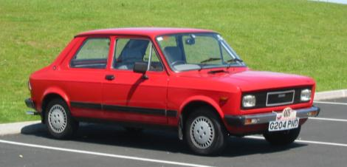

Value

Slide 57
Value in Service

Slide 58
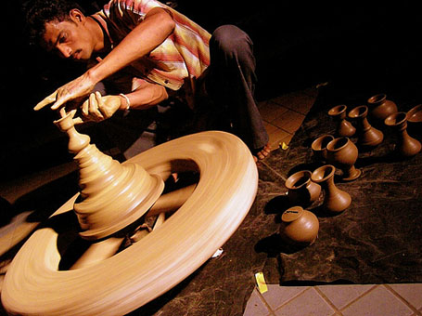
Value Add

Slide 59

Value Enabling

Slide 60
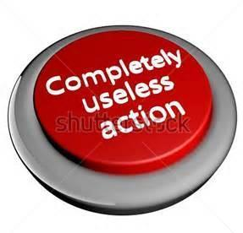
Non-Value Added

Slide 61
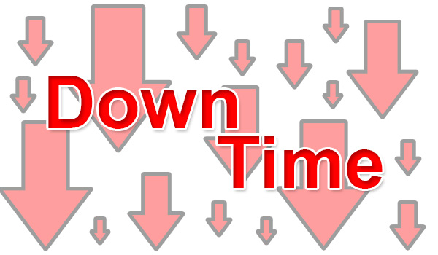
8 Forms of Waste

Slide 62
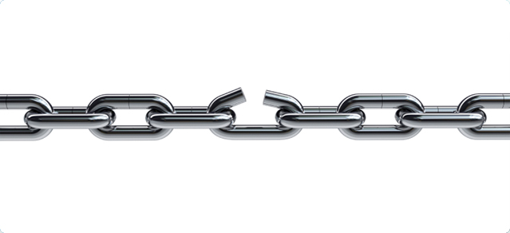
D
Notes:
For defect waste ask:
Do we have data entry errors?
Do we have pricing, quoting, billing, or coding errors?
Do we forwarding partial documentation to the next process?
Do we ever loose files or records?
Do we ever encounter incorrect information on a document?
Any time we have to correct, fix, repair, rework mistakes
In other words, “touch it twice” because we didn’t do it right the first time
Typo’s, missssspelling, grammar, math, negligence, assumptions
Typically, sign-off’s and double-checks are the result of a mistake that was made at some point and someone decided to “check it” in order to fix the problem.
QUESTION: Do “sign-off’s” fix the problem?

Slide 63
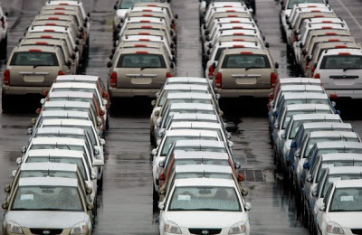
O
Notes:
For overproduction or unnecessary service waste ask:
Are we producing more reports than needed?
Are we making more extra copies than needed?
Are we printing, faxing, e-mailing more than what is needed?
Are we entering repetitive information on multiple work documents or forms?
Are we ordering more services than what is required by the customer?
Any time we make more or do more than is required “just in case…”
Extra manuals, forms, duplicate/triplicate, “group” emails
“Group” email lists – pro’s and con’s
Why do companies overproduce items?

Slide 64
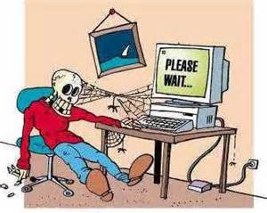
W
Notes:
For waiting waste ask:
Are there excessive signatures or approvals required?
Is there too much dependency on others to complete a task?
Are there delays in receiving information?
Are there computer program version problems causing delays?
Are there cross-departmental resource commitments issues?
Whenever an employee has to WAIT because of a factor outside of their control
Hand-off’s, sign-off’s
Downtime (i.e. computer, internet, machine)
Postponements (meetings, schedules)
Waiting for people to show up for a meeting (or conference call)
Not having what is needed, when it’s needed, where it’s needed

Slide 65

N
Notes:
For the non- or under-utilization of people ask:
Are we in positions we were trained to do?
Can we assist other areas when work is slow in an area?
Can we be trained to do more within the organization?
Ties to Lean Culture
Historically, we did not use the “brain power” of our employees
They were TOLD what to do, not ASKED what they could do
Empowerment
Can we honestly trust workers to make decisions about their jobs that might effect the company?

Slide 66
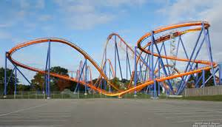
T
Notes:
For transport waste ask:
Are you delivering documents that are not required?
Are you doing excessive filing of work documents?
Do drivers/delivery people have to go back-n-forth?
Any time we physically move something or someone unnecessarily or further than might be necessary.
Chatting along the way
Distance traveled
Hand-off’s the other side of the building
Moving patients around for tests in hospitals.

Slide 67
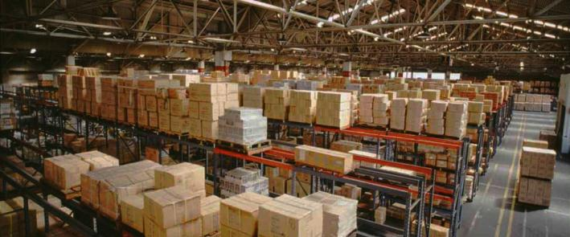
I
Notes:
For inventory waste ask:
Are files (or work) awaiting excessive signatures or approvals?
Are files awaiting task completion by others?
Are we purchasing excessive supplies of any kind?
Do we have any obsolete files in the area?
Do we have obsolete equipment in the area?
Inventory (no matter how small) sucks up real estate, money, effort, and aggravation
Determining what is the RIGHT amount is critical.
Incoming, WIP, Finished Goods.
Give examples of each from multiple industries.
Obsolescence and damage are huge considerations with excessive inventory.
Kanban
Bulk purchasing – “Sin or savings?” Explain.

Slide 68
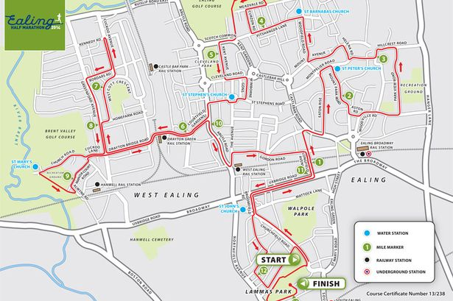
M
Notes:
For motion waste ask:
Are you searching for computer files on your desktop?
Are you searching for work documents (files) in cabinets and/or drawers?
Are you constantly reviewing the same manuals for information?
Are you hand-carrying paper work to another process or department regularly?
Wasted human motion or effort
Ergonomics
Potential safety issue
Time-waster
(1-second example)
What motions exist in your company that could cause injury and/or that waste time and effort?

Slide 69
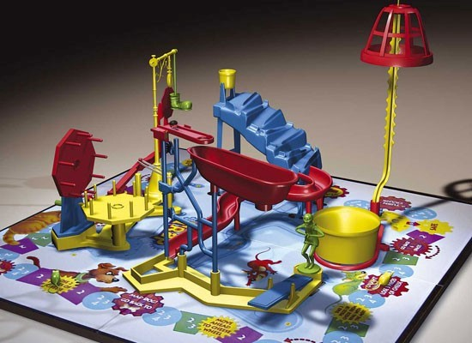
E
Notes:
For extra- or over-processing waste ask:
Are we duplicating reports or information?
Are we entering repetitive data?
Are we doing more work than is required for that
Any time we do something over-and-above what we should do or have to do because our SYSTEM is not robust enough
This one often encompasses some of the other wastes (ie. Defects that cause extra processing).
Excessive copies because we don’t know how many people are coming to a meeting.
Making reports for people who don’t actually want or need them.
Polishing a part when it is not required or mandated.
What are the ramifications of extra processing?

Slide 70

Eyes for Waste
Notes:
At your tables think of waste that you see in your jobs. As a table, try to come up with at least one waste for each category.

Slide 71
GRAPHIC OF ANY TYPICAL VALUE STREAM
The 8 Wastes
NON VALUE ADDED
VALUE ADDED
Typically 95% of
a process is
Non-Value Added!
SO WHY DO WE
FOCUS HERE?
Notes:
____________________________________________________________________________________________________________________________________________________________________________________________________________________________________________________________________________________________________________________________________________________________________________________________________________________________________________________________________________________________________________________________________________________________________________________________________________________________________________________________________________________
AN INTERESTING POINT:
Without implementing a Lean approach, waste generally accounts for 85-95% of total lead time in business.
Value-added
Non value-Added
There are 8 different types of waste. GDC taught us the acronym DOWNTIME to remember all of them.
(Read the list) Each of these will be reviewed with a little more depth on the next 2 slides.

Slide 72

Actual Flow

Slide 73

Ideal Flow

Slide 74

Waste removal Caution
Some Waste is necessary
Notes:
Identify Waste
Understand impact on flow
Address through
Remove
Combine
Reduce

Slide 75
Agenda
Welcome and MLC Overview
Introductions
The History Of Lean
What Is Lean and how it differs
The 8 Wastes
Standard Work Exercise
SQDC
5S
Sustaining and Maintaining the Concepts
What will you do Monday?
Notes:
Standard Font: Arial, size 40 for title

Slide 76
Bronze Body of Knowledge Materials
Chapter 4 Lean Production Simplified
Chapter 3 Lean Thinking
Chapters 4 Gemba Kaizen

Slide 77
Standard Work
Lean Fine Arts Company
Our one and only job is to draw fine Pig artwork!
We have been drawing fine Pigs for over 100 years and our customer expects consistency!
We have been so good, our demand is through the roof and you new hires need to get with it, ASAP!
Now draw me some pigs so we can make money!
Notes:
This exercise is meant to illustrate the need for good Standard Work
It quickly demonstrates the power of Standard Work in continuous improvement efforts and the key that without the basis of Standard Work there is no place to improve from.
Once you have the base it is easy to start implementing concrete improvements, set the standard again then go back into the same cycle of continuous improvement.

Slide 79
Below are instructions for drawing the pig.
1. Draw a letter M at the top left intersection. Bottom center of M touches the intersection.
2. Draw the letter W at the bottom left intersection. Top center of W touches the intersection.
3. Draw the letter W at the bottom right intersection. Top center of W touches the intersection.
4. Draw an arc from the letter M to the top right intersection.
5. Draw another arc from the top right intersection to the bottom right W.
6. Draw an arc between the two bottom W’s.
7. Draw the letter O in the center left box.
8. Draw an arc from the letter M to the tangent of the circle.
9. Draw an arc from the left W to the tangent of the circle.
10. Draw an arc for the eye. Half way between M and circle.
11. Draw an arc for the mouth. Half way between W and circle. Must be a happy pig!!
12. Draw the cursive letter e near the top of arc on the right.
13. And finally draw two dots in the middle of the circle for the pigs nose.
Notes:
HEIDI

Slide 80
Handout 2 of 4
Upward Arc
Downward Arc
Rightward Arc
Spiral
Letter “M”
Letter “W”
Notes:
This can be provided in the hand-outs

Slide 81
Notes:
Placeholder page – don’t want to click ahead by accident

Slide 82
1
4
8
12
10
7
5
11
13
9
6
2
3
Notes:
HEIDI

Slide 83
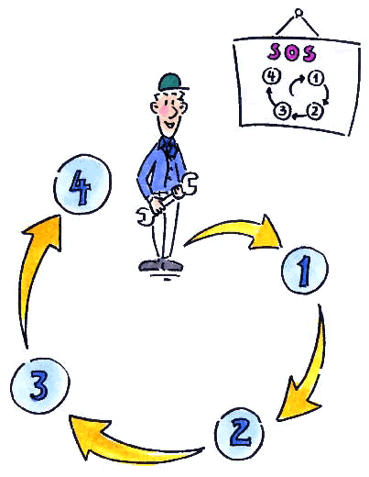
Standard Work
Definition:
The current best documented method to safely and efficiently organize work elements in a repeatable sequence that we know of TODAY.
First I…
Then I…
Then I...

Slide 84
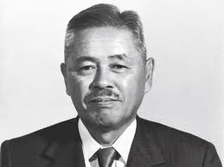
Standard Work
“WITHOUT STANDARDS, THERE CAN BE NO IMPROVEMENT” – TAIICHI OHNO
What does this mean?
Notes:
Standard Font: Arial, size 40 for title

Slide 85
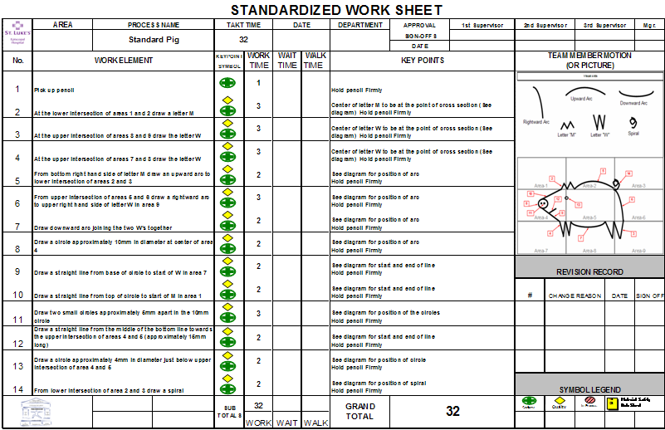
Notes:
European companies – sell globally – instructions are visuals
Ikea and Lego Examples – Pass around

Slide 86
Standard Work
The basis for continual improvement.
A powerful tool for eliminating waste.
A method of building-in quality.
Simple, clear & visual documents showing a Standard method of doing a job.
Results are consistent.
Live and continuously updated documentation, owned by the team.
Ensures correct use of tools and machines.
Shows safe work, based on human movements.
Notes:
Discussion – What do you do with it? What NOT to do with it??

Slide 87
Standard Work
DO:
  Keep standard work simple
  Make it accessible
  Include all info on one, easy-to-read document
  Create one standard work document for each part of the process
  Always look for ways to improve the process.
DON’T:
  Put standard work in a desk drawer
  Change processes without changing standard work
  Make standard work difficult to change
  Give up on standard work – it can be tough, but it’s very important
Notes:
Discussion – What do you do with it? What NOT to do with it??

Slide 88
Agenda
Welcome and MLC Overview
Introductions
The History Of Lean
What Is Lean and how it differs
The 8 Wastes
Standard Work Exercise
SQDC
5S
Sustaining and Maintaining the Concepts
What will you do Monday?
Notes:
Standard Font: Arial, size 40 for title

Slide 89
Bronze Body of Knowledge Materials
Chapter 4 Lean Production Simplified
Chapters 3 Gemba Kaizen

Slide 90
SQDC

Slide 91


S

Slide 92

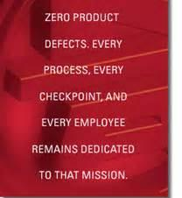
Q

Slide 93
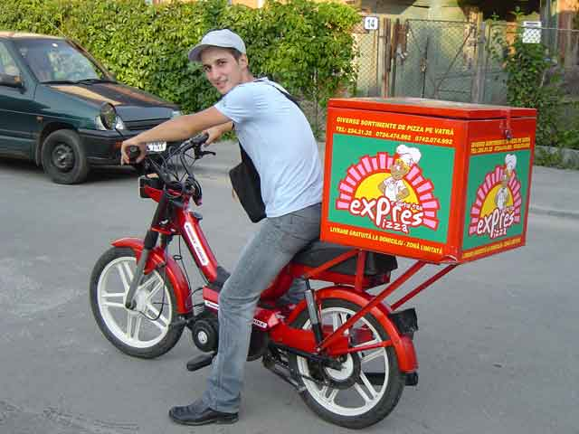
D
Rights of the customer
Product
Quantity
Condition
Place
Time
Cost
Service
Source
Notes:
More Service oriented 8 rights of the customer

Slide 94

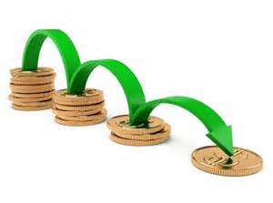
C
Notes:
Activity about SQDC

Slide 95
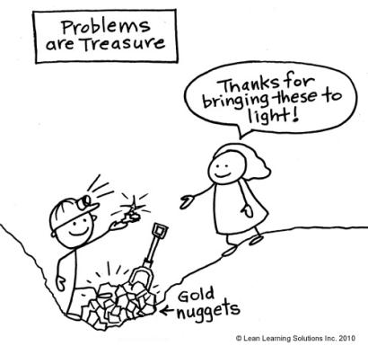

M

Slide 96
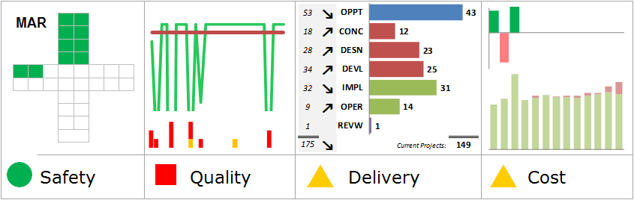
METRICS
Notes:
Who has metrics that would fall into these categories?
At your tables, discuss when you have seen cost improvements that may have compromised safety, quality, or delivery.

Slide 97
Agenda
Welcome and MLC Overview
Introductions
The History Of Lean
What Is Lean and how it differs
The 8 Wastes
Standard Work Exercise
SQDC
5S
Sustaining and Maintaining the Concepts
What will you do Monday?
Notes:
Standard Font: Arial, size 40 for title

Slide 98
Bronze Body of Knowledge Materials
Chapter 3 Lean Production Simplified
Chapters 2,5 Gemba Kaizen

Slide 99
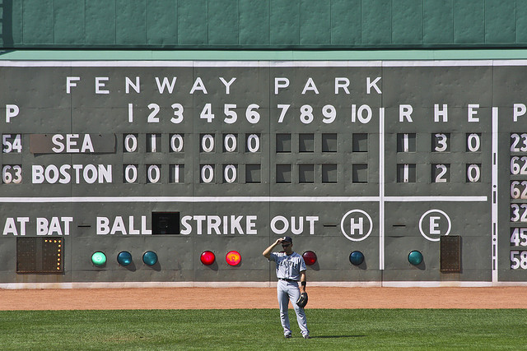
Visual Management

Slide 100
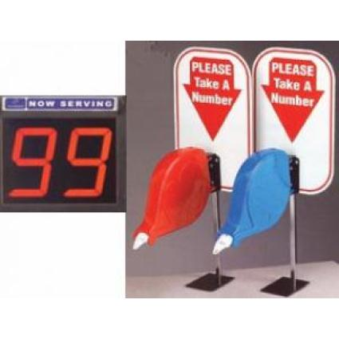

Visual Management

Slide 101
Visual Controls
Visual Management
1
2
3
4
5
6
7
8
9
10
Audio and
Visual Controls
Notes:
Here are some everyday examples of visual and audio controls.
(Talk through the examples on this slide as you emphasize that these tools are not only common, but essential for reasons of safety.)
These traffic devices were created by vehicle users to support safety.
It’s no different in the workplace. Visual and audio controls are tools of communication used by operators, supervisors and customers alike to ensure safety and timelines.
Proper labeling and signage support process improvement by making the workplace “talk” to you.

Slide 102


Slide 103
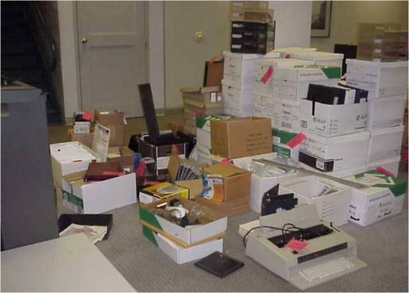
S
Notes:
1) Sort (Sort through & Sort out)
Keep what’s needed -- eliminate what’s not…

Slide 104
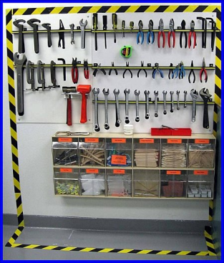
S
Notes:
2) Straighten (Set-in-Order & Set Limits)
Where shall we put it? How shall we store it?

Slide 105
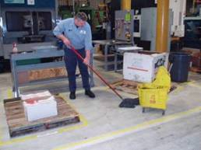
S
Notes:
3) Shine (and inspect through cleaning)
Clean it up and prepare to keep it clean.

Slide 106

S
Notes:
4) Standardize (and share information)
Design and implement Visual Controls
Standardize tools and procedures

Slide 107
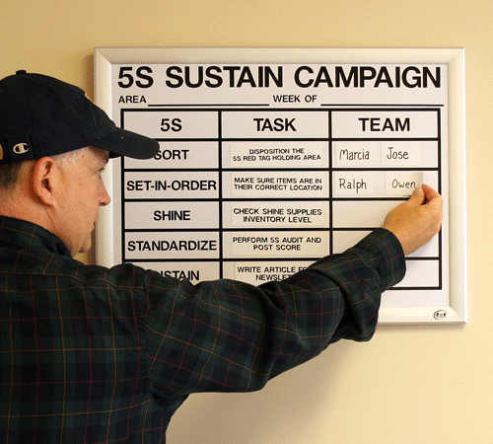
S
Notes:
5) Sustain (Self-Discipline)
Train everyone to new standards
Audit system
Continue to improve

Slide 108
5S
THE NUMBERS GAME
2
1
3
Notes:
Basic instructions slide

Slide 109
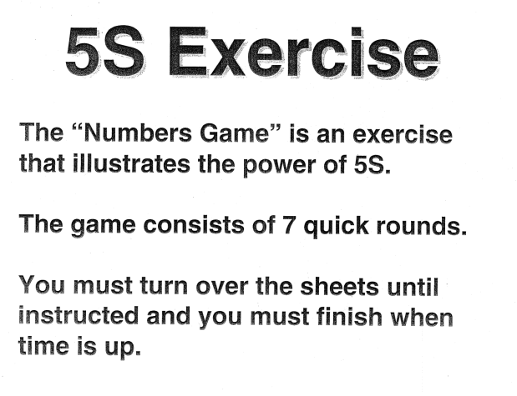
THE NUMBERS GAME

Slide 110

THE NUMBERS GAME

Slide 111

THE NUMBERS GAME

Slide 112

THE NUMBERS GAME

Slide 113

THE NUMBERS GAME

Slide 114

THE NUMBERS GAME

Slide 115

THE NUMBERS GAME

Slide 116

THE NUMBERS GAME

Slide 117

5S
What is the COST of disorganization???
Notes:
Give examples of “one second” that is wasted in your company and think of how it could be eliminated. Make a “case” to present to your boss/co-workers for actually making the change.

Slide 118
SORT – Clearing Up
5S Sort
“What can we get rid of?”
“Where does it go?”
“What needs to be fixed?”
“How do we fix it?”
“When in doubt, move it out!”
Step 1

Slide 119
Red Tagging
5S Sort
    Red Tagging
      Tagging
      Drop area
      Log items (if necessary)
      Review process for area

Slide 120
Red Tagging
5S Sort
Example:
RED TAG
 | Category | Forms Files/Folders Equip/Tools Supplies Other _______
 | Item Name
 | ID Code
 | Dept or Area
 | Date in
 | Name
 | …
 | …
A Red Tag contains information that describes what the item is and what its disposition should be.
Each Red Tag includes the date of when the item was placed in storage.
  Necessity of item in storage is reviewed by date.
Both local and global red-tag areas may be useful for items that are used in different areas.
Notes:
This is an example of a Red Tag. This are NOT set in stone. The items or categories on the Red Tag should reflect the type of items and/or the area that you are working in.
What a Red Tag SHOULD include, however, is the following type of information:
What is it? (it’s name and/or identifier)
Today’s Date (when did we put it in the Red Tag area)
Its disposition (trash, donate, move, repair, etc.)
It’s location (This is filled in at the time that the item is given its final disposition. If an item is being moved within the company, we write where it is to go.)
Note: We often keep a Red Tag Log that shows a “list” of what was moved to another location (i.e. Central Storage), so that people can find it when/if they need it.

Slide 121
STRAIGHTEN/STORE - Organizing
5S Straighten/Store
“The basic point of workplace organization is to fix/set the layout of tools or equipment so that everything is readily available when it is needed.”
Step 2

Slide 122

Is anything missing?
5S Straighten/Store

Slide 123

STORE - Organize
5S Straighten/Store
Organize everything that remains; make locations visible and self-explanatory
Designate storage locations

Slide 124


Visual Control
Storage makes auditing easier
5S Straighten/Store
“A place for everything and everything in
it’s place”

Slide 125
Visual Management
5S Straighten/Store
    VISUAL MANAGEMENT is key
      Labeling
      Signage
      Floor markings, etc.

Slide 126

Visual Guides “You are here”
5S Straighten/Store

Slide 127

Use labels to identify items (1 of 2)
5S Straighten/Store
3/4”
1/2”
7/8”

Slide 128


“Any” Workstation
5S Straighten/Store
Before
After
Create a Place for Everything, and Everything in Its Place
Notes:
1

Slide 129
SHINE - Cleanliness
5S Shine
“A clean workplace makes the unspoken statement that quality work is expected.”
Step 3

Slide 130

5S Shine
Cleaning is Inspection,
Inspection is Detection,
Detection is correction!

Slide 131

This is what “clean” looks like…
5S (‘Do’ Phase)
131
Notes:
This facility has an aggressive 5S program at all levels.

Slide 132
STANDARDIZE - Participation
5S Standardize
Good housekeeping habits should be everyone’s responsibility, including management and staff.
STANDARDS (expectations) must be set and visual.
Step 4

Slide 133
SUSTAIN – Self-discipline
5S Sustain
Sustain
Requires self-discipline
  Discipline is consistently working by the rules and standards of clearing, locating, and cleaning and
commitment from
everyone in the organization
“Inspect what you expect”
Step 5
133

Slide 134
Example: 5S Audit Scorecard
5S

Slide 135

One way to show progress
All Lean projects should have some sort of display board or area, but 5S is the BEST way to show progress…. (Before & After)
Plan in advance to start this board and have it evolve as the project progresses.
135
Notes:
This was a nurse who did scrapbooking and volunteered to do the board. She had very limited supplies. I can only imagine how nice it would have been if she’d had more choices!!

Slide 136
5S Where to Start?
Sustain
Where to start?
Typical companies are highly successful at the first 3 S’s…
Consider starting with system development?
  Who
  What
  When
  Where
  How much (time)
136

Slide 137
Agenda
Welcome and MLC Overview
Introductions
The History Of Lean
What Is Lean and how it differs
The 8 Wastes
Standard Work Exercise
SQDC
5S
Sustaining and Maintaining the Concepts
What will you do Monday?
Notes:
Standard Font: Arial, size 40 for title

Slide 138

OUR THREE JOBS
Notes:
Audience Participation – What are our three jobs?

Slide 139
OUR THREE JOBS
The work
Problem solving
Improvement

Slide 140
Problem Solving
Plan
Do
Check
Act
Improvement
Standard
Time

Slide 141
Sustaining And Maintaining
Improving your process exercise
I need a Volunteer
I am going to improve your process!
Notes:
Ask Dave Kippen about this?
Right hand left hand name writing
Or
Write a sentence and take words out

Slide 142
Sustaining And Maintaining
Time to complete
# of Occurrences
WHY DID THE PRODUCTIVITY TANK?
Notes:
Standard Font: Arial, size 40 for title

Slide 143
Sustaining And Maintaining
It always gets worse before it gets better. Period.
Whatarewegonnadoaboutit!
Notes:
Standard Font: Arial, size 40 for title

Slide 144


Slide 145
Sustaining And Maintaining
Audit for compliance and improvement
Continuous education
Changing behaviors – find a way for success instead of failure
Positive reinforcement
Help each other
Coaching
PDCA, PDCA, PDCA!
Notes:
No back-sliding

Slide 146


Slide 147
Sustaining And Maintaining
Sharing Our Experiences:
Give me examples of Learning Curve success stories, and failures!
Notes:
Standard Font: Arial, size 40 for title

Slide 148








Books of Significance
Notes:
Move this to the very end

Slide 149



Bibliography
The Kaizen Event Planner: Achieving Rapid Improvement in Office, Service, and Technical Environments
Karen Martin, Mike Osterling
Lean Office Demystified
by Don Tapping (Author), Anne Dunn (Author)
MANAGING TO LEARN: USING THE A3 MANAGEMENT PROCESS
by John Shook
Notes:
Theresa and Jerry add suggested reading

Slide 150



Bibliography
LEARNING TO SEE
by Mike Rother and John Shook
2 Second lean
by Paul Akers
LEAn production simplified
by Pascal Dennis
Notes:
Theresa and Jerry add suggested reading

Slide 151


Bibliography
Everything I learned about lean I learned in first grade
by Robert O Martichenko
Toyota kata
by Mike Rother

Slide 152
Agenda
Welcome and MLC Overview
Introductions
The History Of Lean
What Is Lean and how it differs
The 8 Wastes
Standard Work Exercise
SQDC
5S
Sustaining and Maintaining the Concepts
What will you do Monday?
Notes:
Standard Font: Arial, size 40 for title

Slide 153


So, What Are You Going to Different Tomorrow
The world won’t get any better
if all you do is sit there and watch

Slide 154
So, What Are You Going to Different Tomorrow
Your ideas?
Start with personal reflection (Do you believe?)
Organization assessment (large organization start with what you control).
Value Stream / Process Mapping (other discovery tools).
Pick an area and start PDCA cycle
Don’t wait! Get your Learn on!

Slide 155


Slide 156
Reflection
Everyone stand up and come to the front of the room and let’s discuss the training…
What went well | What should we change
Notes:
Standard Font: Arial, size 40 for title

